Slide 1


Slide 2

Presentation of information
for Social Care professionals
working with families using
FAMILY STAR method
FAMILY STAR method
Bradford 19th of August 2020

Slide 3
Main goal of our international seminar
The main goal of the event is to share, discuss and circulate the outcomes of materials that are available in Polish and English and to adapt the method of working with families which are at risk of social exclusion including immigrant families.
The aim of the event is to enable an implementation and development of a universal set of tools along with a manual for their use to support Family Workers and to raise professional competences of people working in the social care sector.
This will help them the social care sector to support families having difficulties in properly fulfilling the care and educational function of their families including dependants.

Slide 4
FAMILY STAR program
FAMILY STAR programme consists of various strategies developed for the Social Workers and Social Care Workers in Poland, UK, Ireland.
The tools, tests, forms, templates, cards, questionnaires are widely used to support parents/ careers and their families by local authorities and voluntary sector services.
Tools and resources can also be used to capture the voice of clients’ perspective and needs.
This method enables Social Workers and Social Care workers to be more efficient in their work with no place for being subjective. Rich content developed during this project will give workers and clients the effect of synergy alongside effective parenting strategies.

Slide 5
FAMILY START – Who is it for?
An international group of experts, representing three partner organizations and working in the social assistance sector, dealing with education and training of adults developed a competence standard (FAMILY STAR) for:
- Social Workers
- Family support worker assistants
- Social worker assistants

Slide 6
FAMILY START is a programme for professionals to help to be ‘updated’ with an increasing fragmentation of social work into a series of distinctive tasks or roles - such as child protection, adult mental health or working with disabled people - potentially diminishes collective professional identity.
Our work on this topic has led us to consider social work professionalism as a shared endeavour, with common values, norms and culture, in which - despite initial appearances - we are all engaged together.

Slide 7
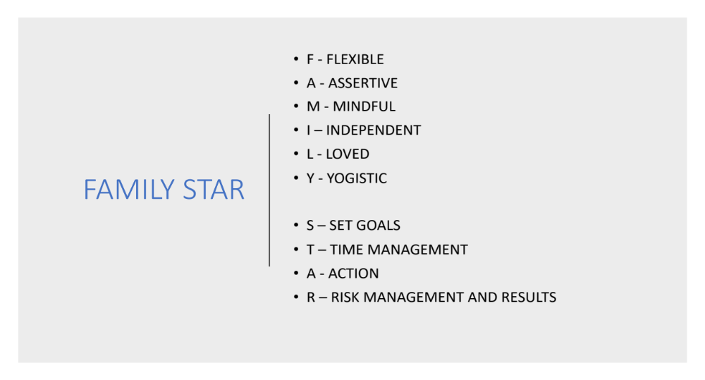
Key areas of skill
We have identified certain key areas of skill that we consider to be important for autonomous professional practice across all social work roles:
These areas are best thought of as ‘organising themes’ for thinking in a holistic way about professional skills.
Being flexible for example means that the Social Workers and Social Care workers should be able to adapt the best strategies for a client and the client’s family.

Slide 8
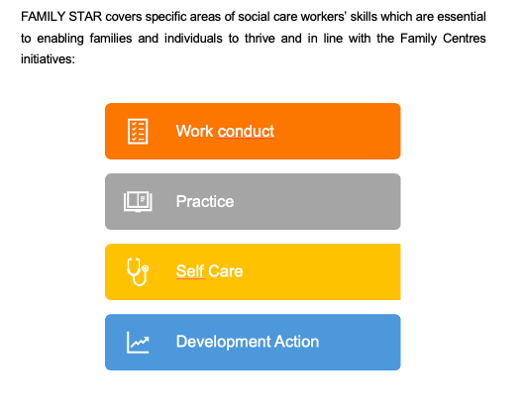

Slide 9
What does the starndard include ?
The standard will include:
- Tools facilitating independent diagnosis of employee competences and skills, used to identify competence gaps and selection of appropriate teaching methods and educational path,
- Social assistance worker model - a list of competences that the social assistance worker should have,
- Educational path how to become a Social Worker in Poland, UK and Ireland
- Educational path how to become a social care worker in Poland, UK and Ireland

Slide 10
FLEXIBLE STRUCTURE OF THE STANDARD - FAMILY STAR
The standard will have a flexible structure, and its modules and modular units can be updated (modified, supplemented or replaced), without destroying the structure of the standard, to adapt the content to make possible corrections and further additions.
Thanks to this:- the educational process (teaching and learning) will be focused on achieving specific, measurable learning outcomes in the form of knowledge, skills and social competences enabling the performance of specific professional tasks,- the principle of transfer of knowledge in lifelong learning sector, skills and social competences previously acquired by the participants in the course of formal, non-formal and informal learning in the work environment will be widely used and implemented via cascade training at work.

Slide 11
FAMILY STAR program strategies
FAMILY STAR programme consists of various strategies developed for the Social Workers and Social Care Workers in Poland, UK, Ireland.
The tools, tests, forms, templates, cards, questionnaires are widely used to support parents/ careers and their families by local authorities and voluntary sector services.
Tools and resources can also be used to capture the voice of clients’ perspective and needs.
This method enables Social Workers and Social Care workers to be more efficient in their work with no place for being subjective.
Rich content developed during this project will give workers and clients the effect of synergy alongside effective parenting strategies.
Social workers and social care workers will be required to use the same tools.

Slide 12
FAMILY STAR development collaborators
FAMILY STAR method will help to look differently at the social assistance for a client through properly constructed forms and questions, as well as the assessments developed by and for the social assistance client and worker.
It is an innovative method due to the nature of the documents used and the win-win approach.
This method requires a partnership.
There is no place for inequality. A social worker and social care worker must be equally satisfied with the
work done and the plan created, so that there is no discomfort from the work being done by the worker.
This will ensure effective overcoming of burnout, which often affects workers in this industry.
Also, the client must be equally satisfied with the work done and the plan created, so that there is no discomfort from the work being done by the client.
This will ensure effective overcoming of burnout of the workers, which often affects Social Care field.

Slide 13
FAMILY START SUMMARY
Significant policy changes and the number of Poles living in the UK and Ireland, the increasing number of immigrants living in Poland, brought the legal protection of the title ‘Social Worker’, which shifts in the educational requirements for social work from diploma-level to degree-level, recognition of the need for national regulation of Social Workers and social care workers.
Depending on individual’s point of view, these developments can be seen as enhancing professionalism (which, after all, is usually stated as the intention of such policy measures). Alternatively, the increased government control of social work – such as inspections and prescribed procedures - can be interpreted as undermining professional skills, expertise and autonomy.

Slide 14
As part of the event the following results of intellectual work will be shared:
1. Standard of professional competence for social workers, family assistants and family coordinators
2. Tools for performing professional tasks by social workers - FAMILY STAR program
3. Guide and instructions for social workers / family support workers on how to work with the family using the
FAMILY STAR tools
During the event in this difficult COVID era we will also find time to network not only locally but also nationally
and internationally.
You will find the outcomes:
https://www.edusmart-tc.net/level-up-outputs

Slide 15
Thank you for your attention
Dominika Marcinkowska
EDU SMART TRAINING CENTRE LIMITED IRLAND
office@edusmart-tc.net
https://www.edusmart-tc.net/level-up-outputs

