Slide 1






CANVA
INSHOT
PRESENTATION

Slide 2

CANVA - CONTENT INTRODUCTION

Slide 3
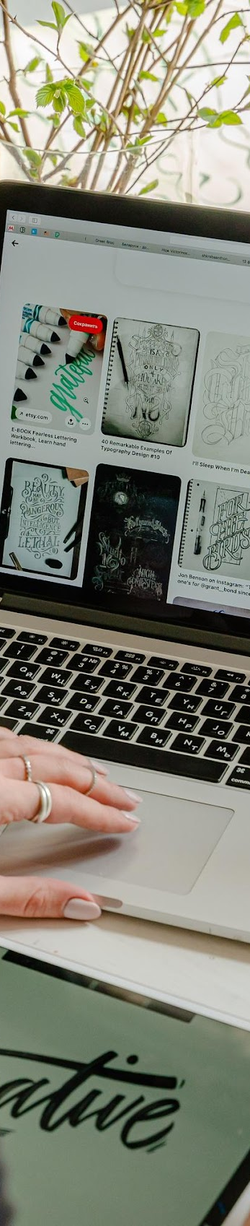
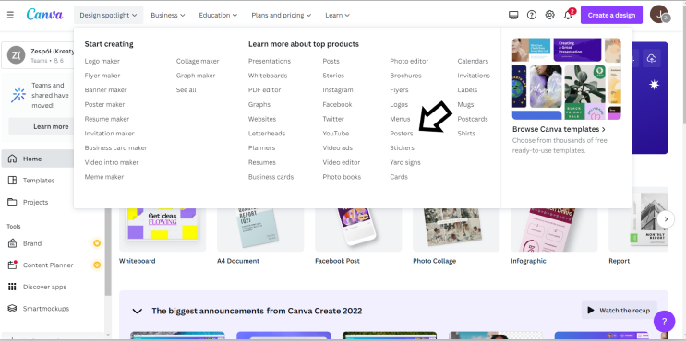
STEP 1. Log in to Canva.
STEP 2. On the main page, in the upper left corner, in the "Design spotlight" tab, select the "Posters" option.
HOW TO DO IT?

Slide 4
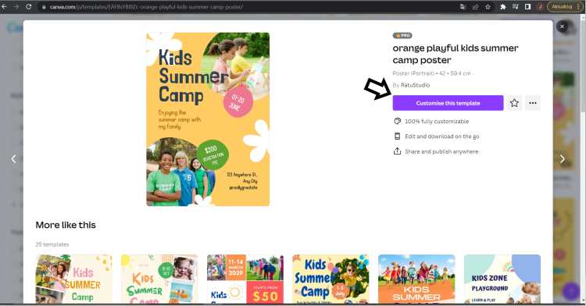
STEP 3. Click on the poster template of your choice and then select "Customize this template".
HOW TO DO IT?

Slide 5
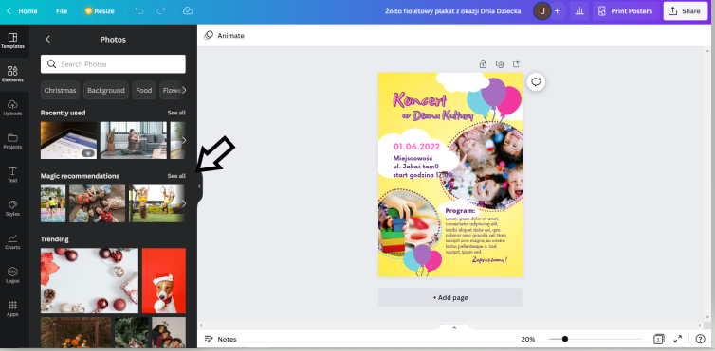
STEP 4. From now on, you can freely edit the poster of your choice. According to the content of the task, transfer the information about the event from Job Card No. 3 to the poster.
Change the content of the advertisement by clicking in the place of the text and entering your own.
You can also change photos by adding photos selected from Canva.
STEP 5. Are you wondering how to change the photos on the poster?
Select the "Elements" tab on the left side of the bar and then "Photos - see all".
HOW TO DO IT?

Slide 6
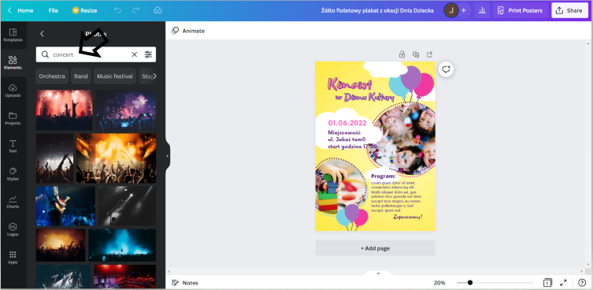
In the search box, you can enter the type of photos you are interested in and choose one of them.
HOW TO DO IT?

Slide 7
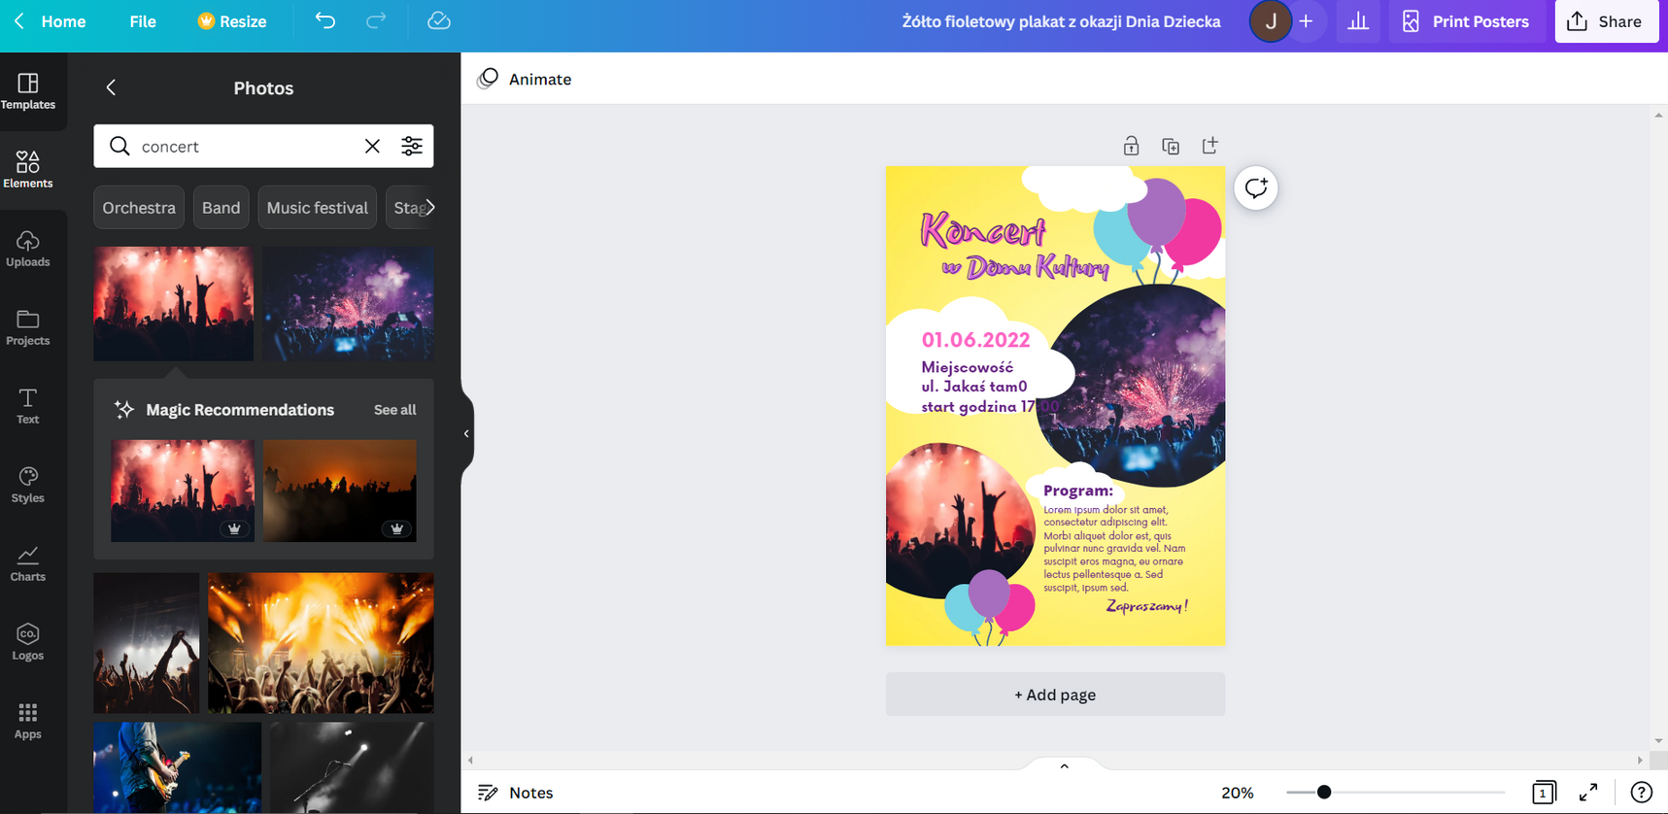
Select the photos you want to add to the poster and drag them with the mouse cursor towards the project.
HOW TO DO IT?

Slide 8
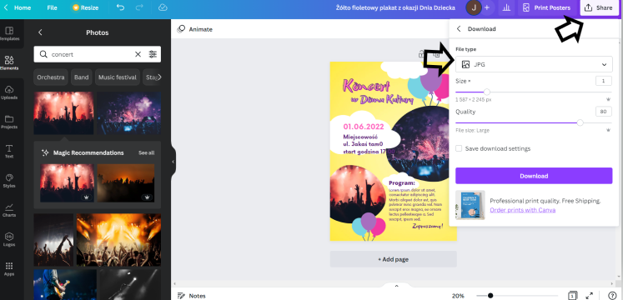
STEP 6. Download the poster as a JPG file by clicking on the top right corner "Share" then "Download" and select "File Type" → "JPG" and click "Download".
HOW TO DO IT?

Slide 9
CREATE A COLLAGE IN CANVA

Slide 10
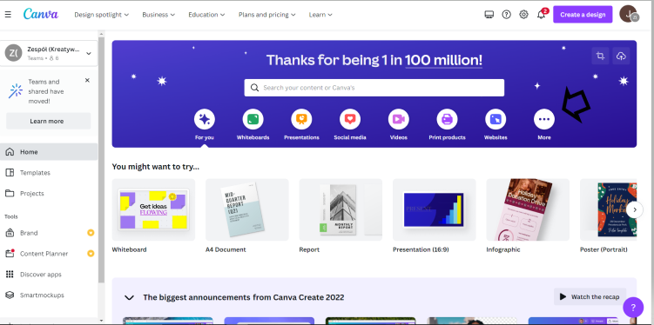
STEP 1. Log in to Canva.
STEP 2. Click on "More".
HOW TO DO IT?

Slide 11
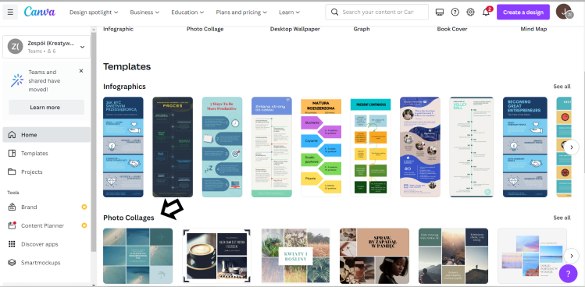
STEP 3. In the "Templates" option, select the "Photo Collages" option.
HOW TO DO IT?

Slide 12
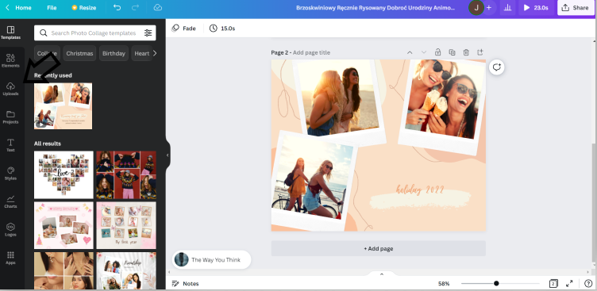
STEP 4. In the "Photo collages" tab, choose a template according to your preferences.
STEP 5. After choosing a template, edit the collage by adding your own photos. Select "Upload" in the left bar and select the "Images" tab.
HOW TO DO IT?

Slide 13
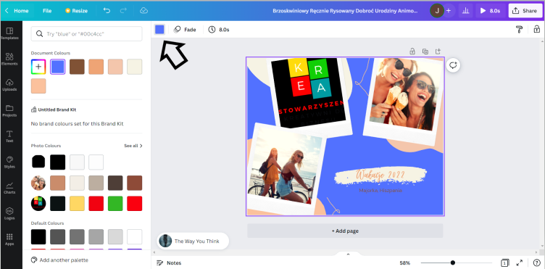
STEP 6. From the "Images" tab, select the photos you want to add to the collage and drag them with the mouse cursor towards the project.
STEP 7. Change the collage title by clicking in the text place and typing your own.
STEP 8. Change the background in the graphic by clicking on the collage and then in the upper left corner on the icon with colors and choose the color you prefer.
HOW TO DO IT?

Slide 14
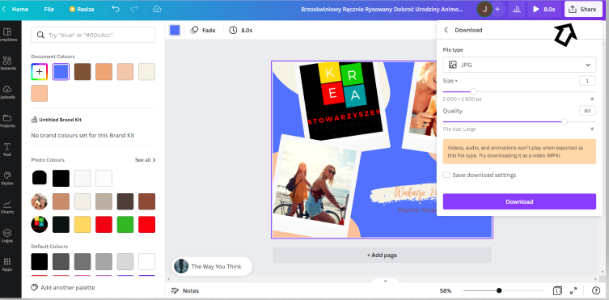
STEP 9. Download the collage as a JPG file by clicking on the top right corner "Share" then "Download" and select "File Type" → "JPG" and click "Download".
HOW TO DO IT?

Slide 15
EXERCISES
2. COLLAGE DESIGN
Create a collage with photos from the most interesting places in the country you come from. Add a title and subtitles.
LEADER:
PARTNERS:

Slide 16
YOUR OWN INVITATION DESIGN

Slide 17
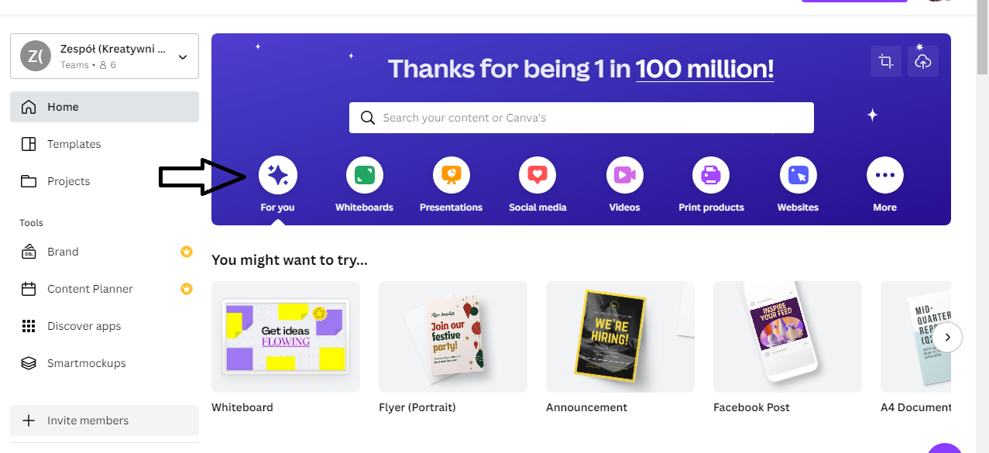
STEP 1. Log in to the CANVA program.
STEP 2. Click "For You".
HOW TO DO IT?

Slide 18
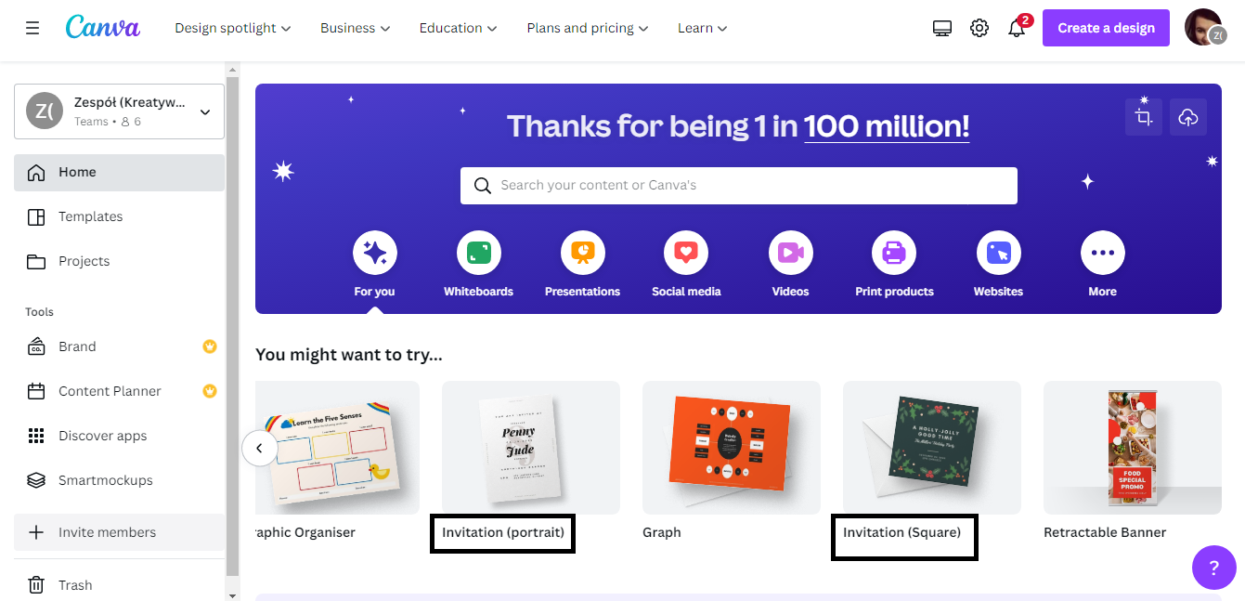
STEP 3. Then select the format of the invitation. You have two options: "Invitation (portrait)" and "Invitation (square)".
HOW TO DO IT?

Slide 19
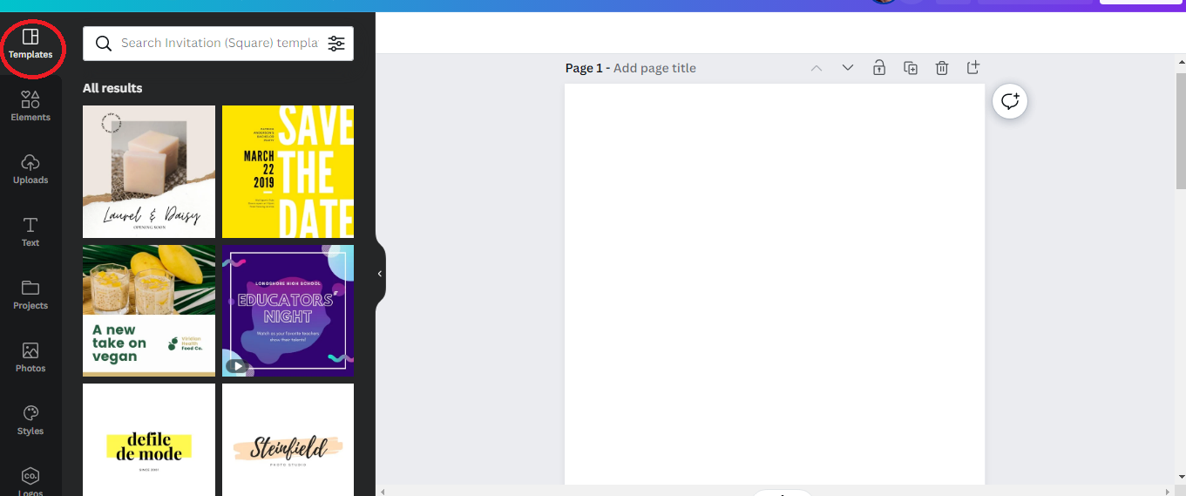
STEP 4. Once you have chosen the format of the invitation, the next step will be to choose the template. The "Templates" option is available in the bar on the left side of the interface.
HOW TO DO IT?

Slide 20
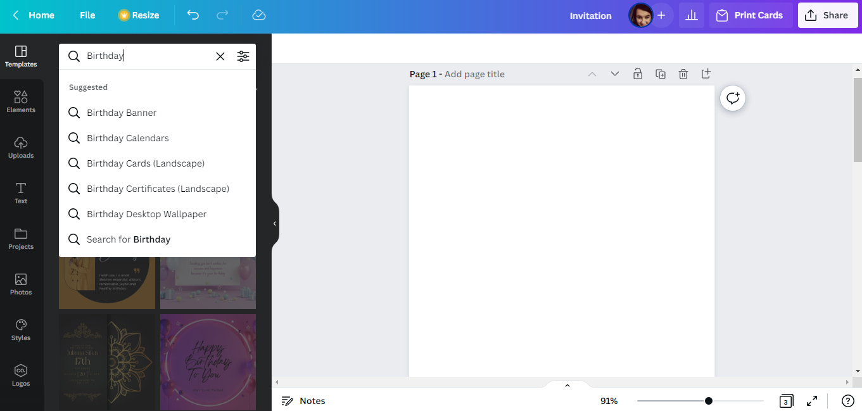
To facilitate the selection of the invitation template, on the template bar in the upper left corner, you can enter the subject of the event for which you are designing the invitation !!!
HOW TO DO IT?

Slide 21
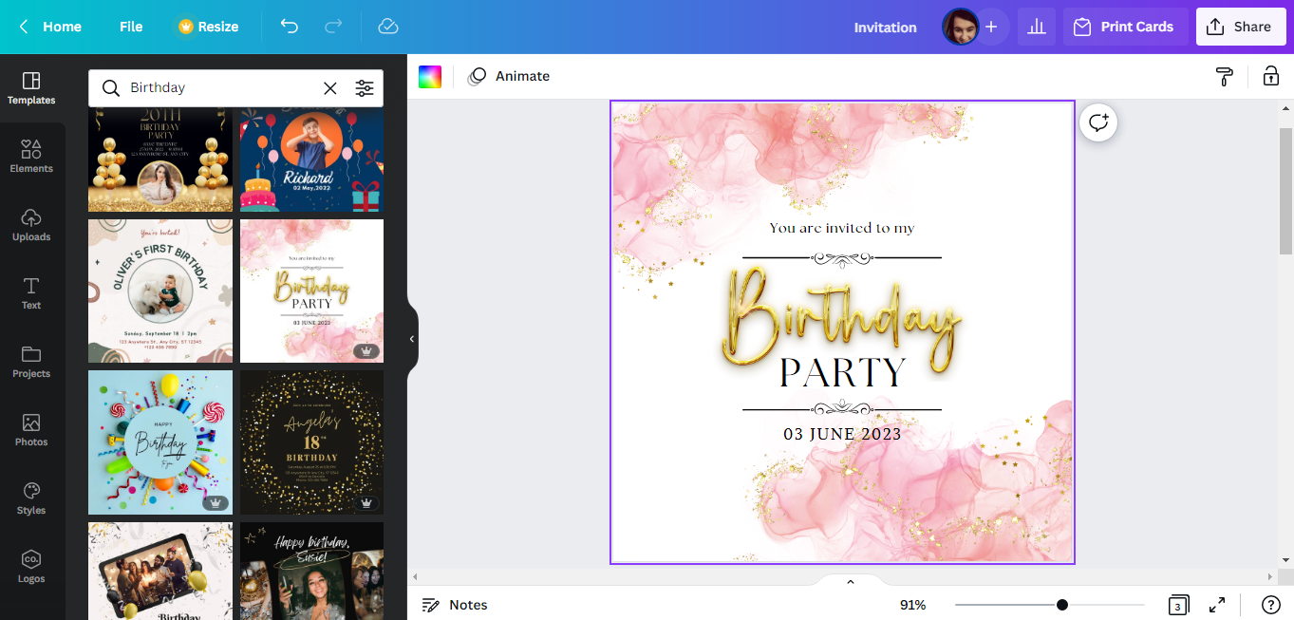
STEP 5. Choose a template according to your preferences.
HOW TO DO IT?

Slide 22
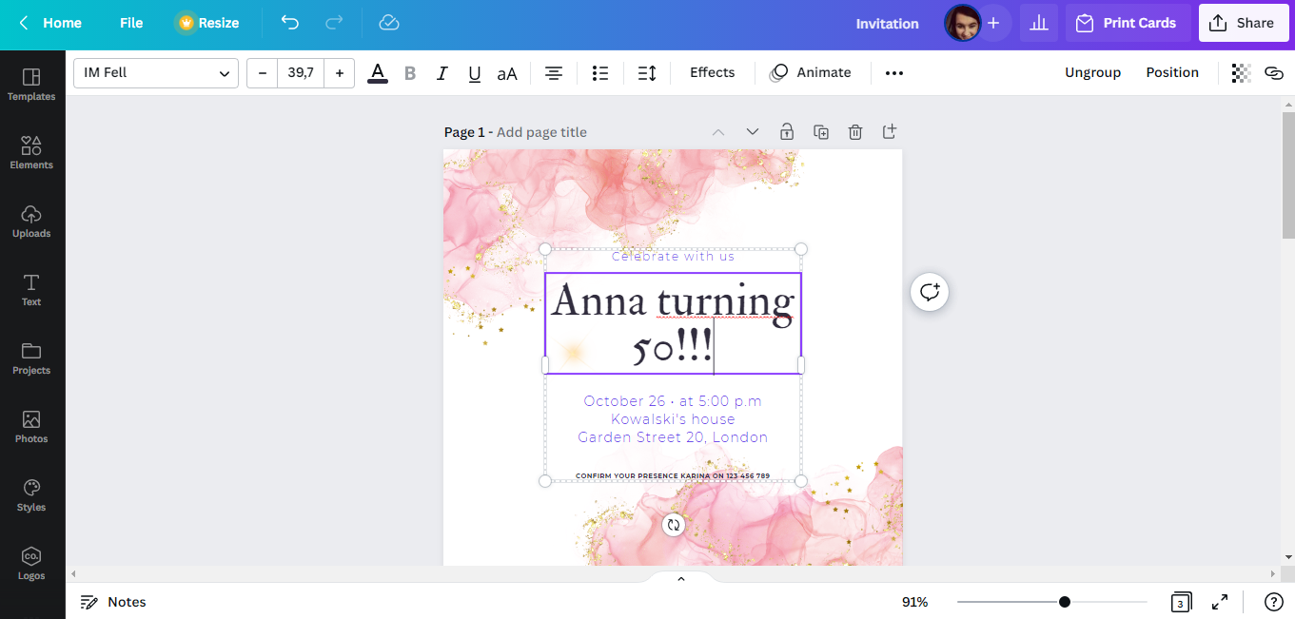
STEP 6. After selecting the template, modify the text of the invitation, entering the details of the party organized by you.
HOW TO DO IT?

Slide 23
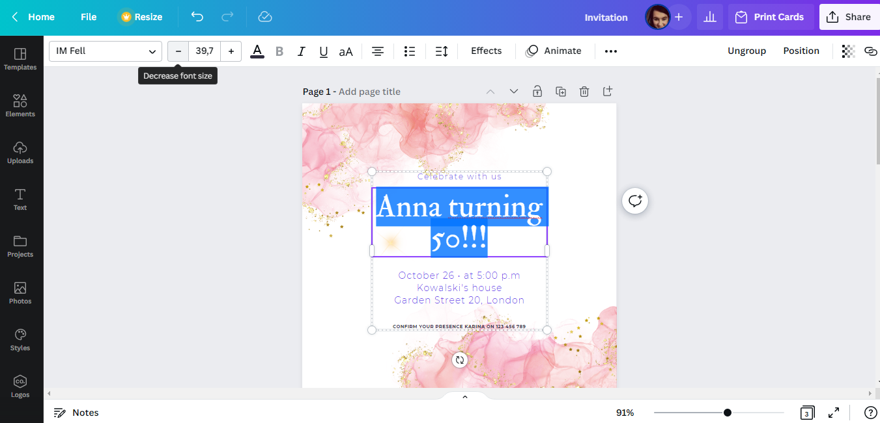
REMEMBER!!!
In the CANVA program you can change the type, size and color of the font.
You can also make the text bold, use the italic option, change the amount of space between words and even letters in a word.
HOW TO DO IT?

Slide 24
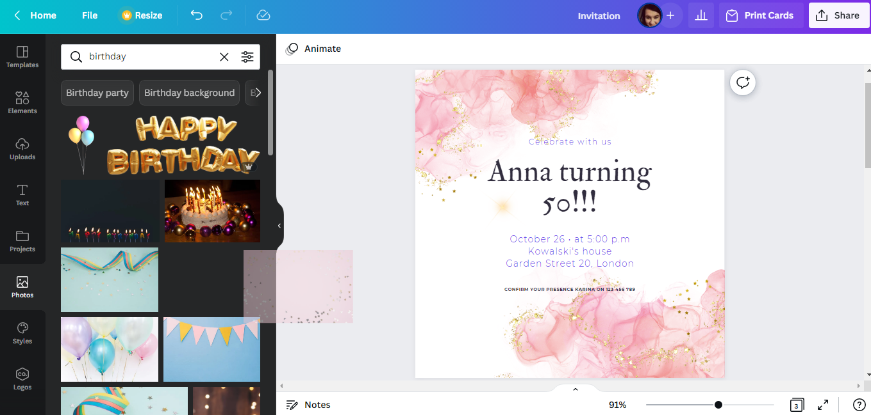
STEP 7. The next action you can do is change the graphics of the invitation. It is possible by changing the background (e.g. choosing a different photo).
To do this, select the "Photos" option, and then enter the subject of the project in the "Search anything from Canva" box. This will give you a full array of photos that you can use.
HOW TO DO IT?

Slide 25
After making your selection, drag the photo with your mouse towards the invitation design.
HOW TO DO IT?

Slide 26
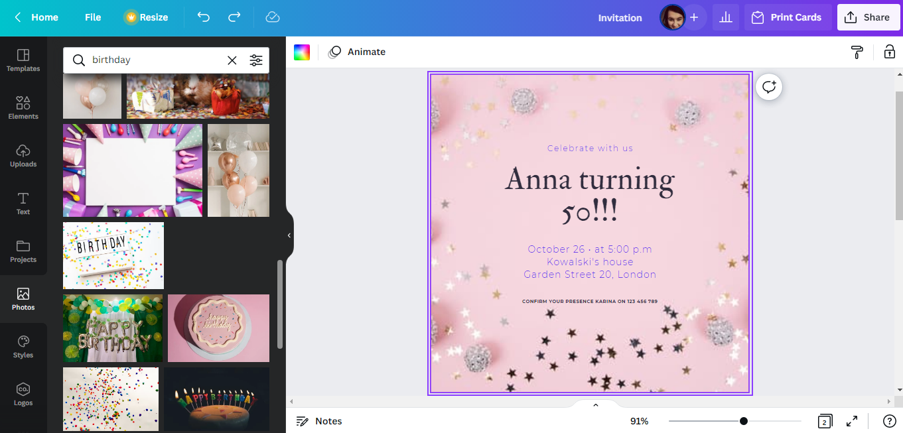
Then plot the photo on the invitation design. The background will change automatically.
HOW TO DO IT?

Slide 27
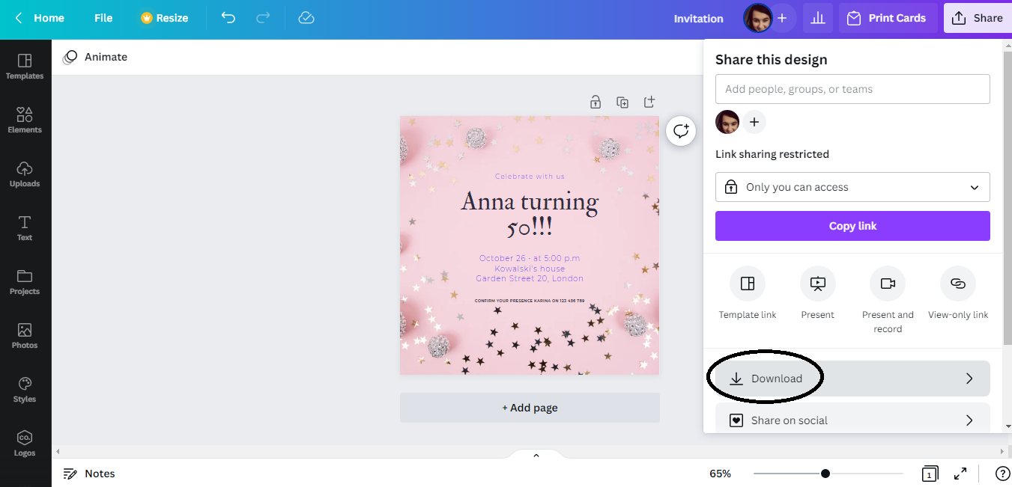
STEP 8. After finishing work, download the graphics for printing. You can do this by selecting the "Share" option in the upper right corner of the interface, and then "Download".
HOW TO DO IT?

Slide 28
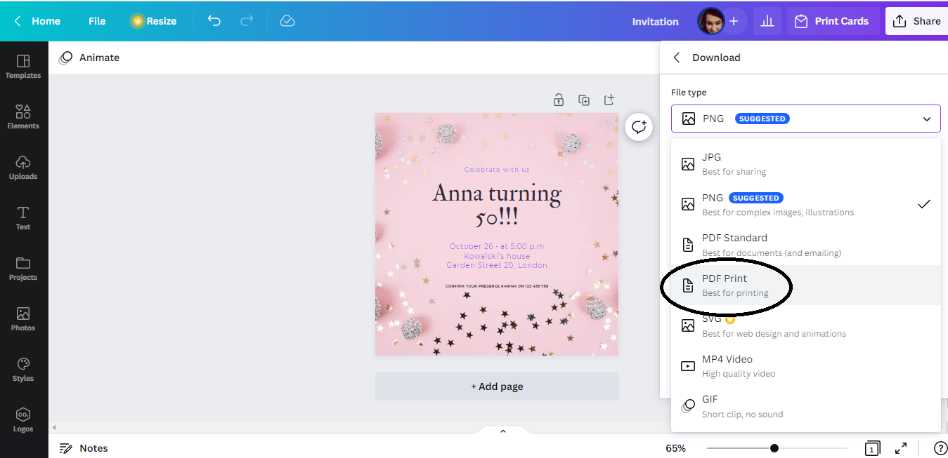
The recommended format for downloading graphics is "PDF Print".
HOW TO DO IT?

Slide 29
EXERCISES
3. INVITATION DESIGN
Using the CANVA program, design an invitation to the vernissage that will take place on May 12, 2023 in Opole. Make sure the invitation includes all the details of the event.
LEADER:
PARTNERS:

Slide 30
MOVIE MAKING: INSHOT, IMOVIE AND CANVA

Slide 31
EXERCISES
4. MOVIE MAKING: INSHOT, IMOVIE AND CANVA
Record four 5-second videos from today's workshop and then use the above applications to combine the videos into one video. Also add music.
LEADER:
PARTNERS:

Slide 32

INSHOT
HOW TO DO IT?

Slide 33

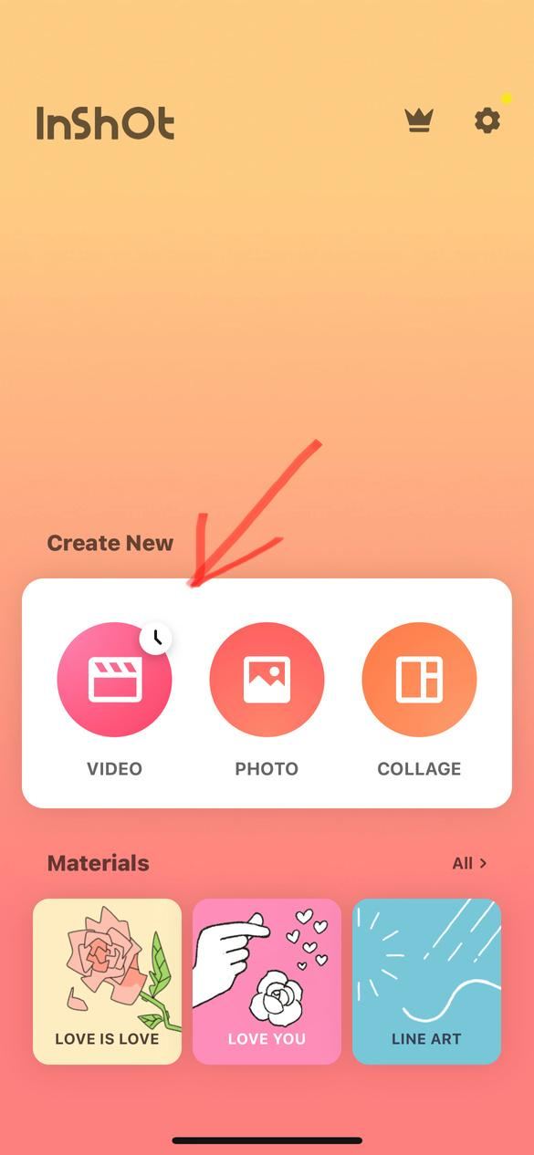
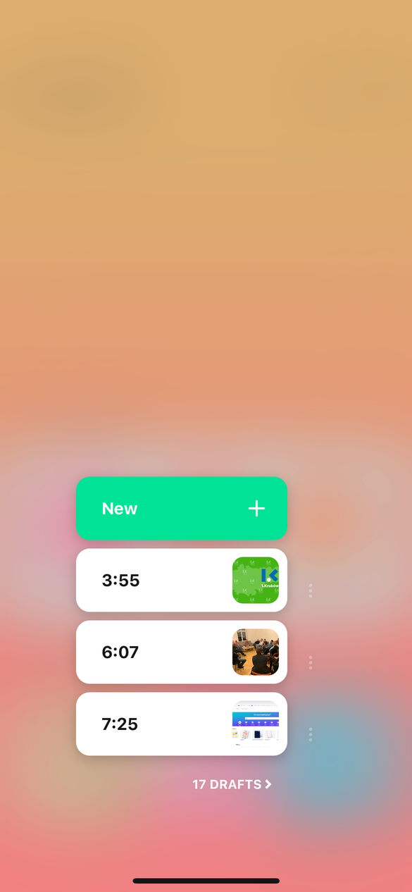
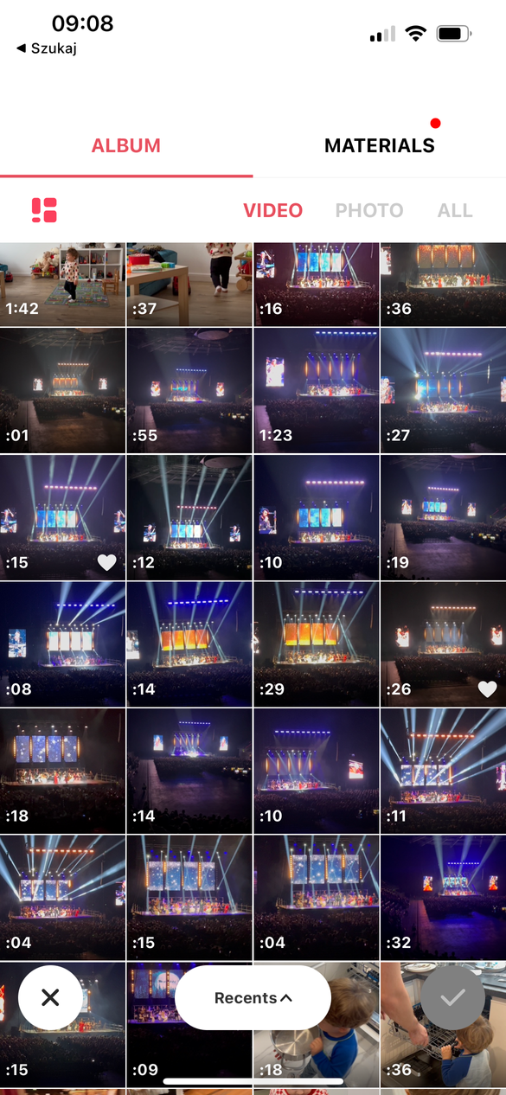
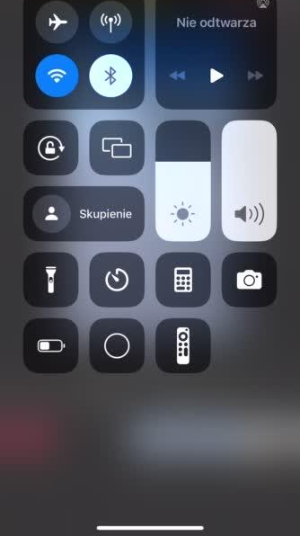
How to rearrange videos and add music?
  Click on the video you want to replace and swipe to where you want to place it
  CLICK „MUSIC” and add Your favourite music

Slide 34
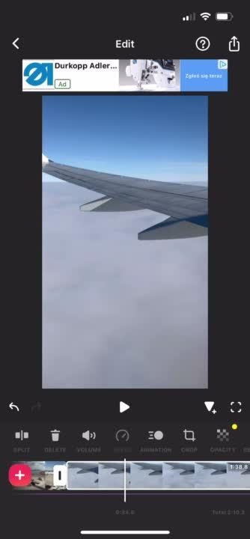
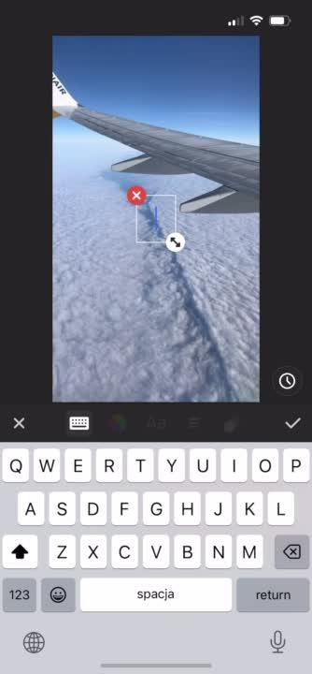
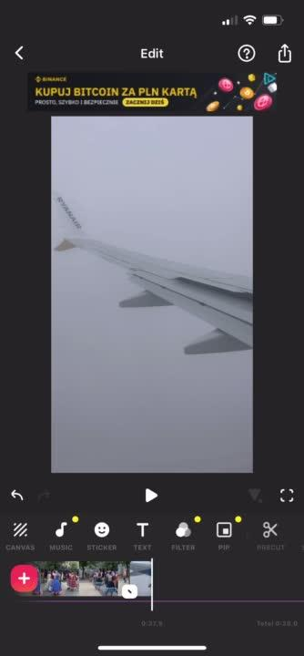
How to change the video speed?
  CLICK "SPEED"
How to add subtitles and change color?
  CLICK „TEXT”
How to resize the video?
  Click „CANVAS”

Slide 35
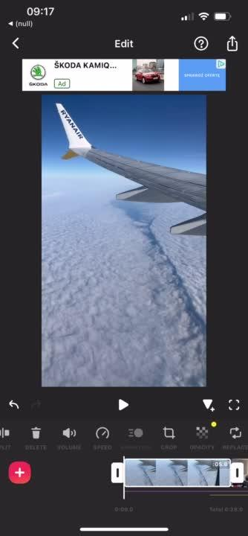
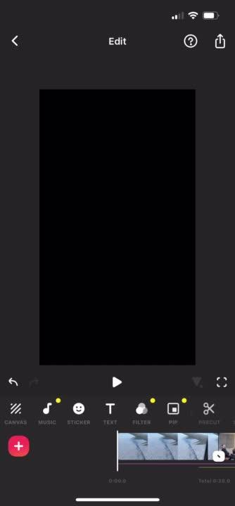

CLICK „ANIMATION” and add Your favourite music
Download your film

Slide 36
EXERCISES
LEADER:
PARTNERS:

Slide 37

Q&A SESSION

Slide 38

Thank you
for attention

