Slide 1



WORKSHOP DAY 2
ESG in Agriculture
28 March 2023 Warsaw, Poland

Slide 2
What is Agriculture?
Agriculture relates to the cultivation of crops and grazing of animals for food, raw materials, and secondary produce.
Preparation of plant and animal items for human utilisation and distribution of products to retailers also falls under agriculture.
In addition, most of the textiles in the world are produced by agriculture, generating produces such as leather, wool, and cotton. Products such as paper and construction timber are also created.
Source: https://education.nationalgeographic.org/resource/agriculture

Slide 3
ESG in Agriculture: Brief Introduction
ESG – Environment, Social and Governance strategies which are implemented into the image and mission of a company: when it comes to the agricultural sector, it is often recognised as part of the ‘Environment’ factor. However it must be remembered that it is crucial for the balance of institutions which create the agricultural sector, as well as to comply with EU Taxonomy regulations, to focus on the social and governance strategies to the same degree.
Agriculture has a direct relation to all societies, whether nomadic farming or high intensive, as food is a core human need. Historically ESG in Agriculture can be traced back to permaculture, organic farming, and even perennial crop use back when crop farming began 10,000 years ago when humans began to domesticate plants and animals.
It can be argued that in order to link the importance of preserving ecosystems with ethical governance, societies such look back and see how we can use the ‘first ever good practise’ at diverse levels within the European Union and beyond.

Slide 4
Agriculture key terms defined
Primary production – includes fishing, farming and rearing of livestock; natural sources
Secondary Production – conversion of animal and crop produce into goods and products
Land use – whether land is used for pastoral farming (animal rearing), arable farming (crops) or mixed farming (both)
Soil – Soil problems such as erosion, decline in organic matter, salinisation, biodiversity loss, landslides, and desertification are a threat to our efforts in mitigating and adapting to climate change. Soil is the key for crop growth and must be protected and developed to allow for sustainable farming
Water - Increased droughts and water scarcity due to the decreased availability of freshwater and less predictable rainfall patterns due to shifts in global weather patterns. Water is essential for crop growth and animal production.
Food management - refers to the acquisition of food from the very beginning of primary production, right up until the end of its lifespan when it ends up in our household waste or composting. Strategies to ensure food management need to be implemented across vertical levels such as bettering food storage, retail ‘use by date’ management or meal planning for families.

Slide 5
Agriculture in regard to the EU Taxonomy
The EU taxonomy is a new regulation which has officially been put in place in January 2022. It includes a framework which outlines, explains, defines and classifies “green” or “sustainable” economic activities within the EU, as there was previously no clear legislation.
The EU taxonomy includes six environmental objectives:
Climate change mitigation
Climate change adaptation
Sustainable use and protection of water and marine resources
Transition to a circular economy
Pollution prevention and control
Protection and restoration of biodiversity and ecosystems
Agricultural economic activity in the EU falls under each of the six objectives. In terms of climate change mitigation and adaptation, the difference between them is that adaptation relates to the process of adjusting to the effects of climate change (such as having to increase irrigation due to droughts, changing the type of crops which are planted due to changing weather patterns or using new technologies) while mitigation means reducing the impacts of climate change through preventative measures of greenhouse gas reduction (reducing the amount of forest cover cleared for animal grazing or not using plastic packaging for fresh foods).
Source: https://eu-taxonomy.info/, https://www.eea.europa.eu/help/faq/what-is-the-difference-between#:~:text=In%20essence%2C%20adaptation%20can%20be,(GHG)%20into%20the%20atmosphere.

Slide 6
Agriculture in regard to the EU Taxonomy Continued - Compass
The EU Taxonomy Compass provides a visual representation of the contents of the EU Taxonomy. The compass will continue to be updated in the future to include criteria for additional activities which contribute to and fall under the six environmental objectives of the Taxonomy Regulation.
Using the EU Taxonomy Compass website users can see activities included in the EU Taxonomy (termed taxonomy-eligible activities). This allows managers and companies to precisely highlight which objectives they contribute to with their environmental, social and governance activities. They can also check specific criteria they have to meet under the new regulations so that they can be considered ‘taxonomy-aligned’.
Examples of activities within the Compass which relate to Agricultural activity include: Restoration of wetlands, Afforestation, Anaerobic digestion of bio-waste, or Composting of bio-waste.
Source: https://ec.europa.eu/sustainable-finance-taxonomy/taxonomy-compass

Slide 7
Deforestation – new regulation on deforestation-free supply chains under the European Green Deal
10% of the world’s forests (area larger than the EU), have been lost worldwide lost to deforestation between 1990 and 2020. The European Commission explains that deforestation is a main driver of climate change and biodiversity loss (key ESG EU taxonomy objectives).
The new regulation on deforestation-free supply chains was agreed in December 2022 where all relevant companies and traders will “have to conduct strict due diligence if they place on the EU market, or export from it: palm oil, cattle, soy, coffee, cocoa, timber and rubber as well as derived products (such as beef, furniture, or chocolate)” (European Commission, 2022).
Soon, all EU member states will need to make sure that “not complying with the rules leads to effective and dissuasive penalties”. Specific policy under the new regulation includes “Cooperation with partners EU cooperation with partner countries through partnership, forest and multilateral environmental agreements”. This falls under the governance aspect of ESG – many new laws are being introduced which agriculture related companies will need to be aware of and will have an impact on the global markets.
Source: https://environment.ec.europa.eu/topics /forests/deforestation_en , https://ec.europa.eu/commission/presscorner/detail/en/ip_22_7444, https://environment.ec.europa.eu/topics/forests/deforestation/regulation-deforestation-free-products_en

Slide 8
Deforestation – new regulation on deforestation-free supply chains under the European Green Deal Continued
Soon, all EU member states will need to make sure that “not complying with the rules leads to effective and dissuasive penalties”. Specific policy under the new regulation includes “Cooperation with partners EU cooperation with partner countries through partnership, forest and multilateral environmental agreements”.
This falls under the governance aspect of ESG – many new laws are being introduced which agriculture related companies will need to be aware of and will have an impact on the global markets.
Source: https://environment.ec.europa.eu/topics /forests/deforestation_en , https://ec.europa.eu/commission/presscorner/detail/en/ip_22_7444, https://environment.ec.europa.eu/topics/forests/deforestation/regulation-deforestation-free-products_en

Slide 9
Use of chemicals in agriculture
Pesticides include insecticides, fungicides, herbicides. Special training, certification and approval must be taken in order to use pesticides at a large scale. Pesticides may be hazardous substances and dangerous for human health and ecology around them, therefore precautions must be taken in acquisition, storage, use, and disposal of pesticides.
The EU is controlling the use of pesticides through approval of all active substances found within pesticides by the European Commission. The European Food Safety Authority (EFSA) is the responsible EU Agency for pesticide use and they provide detailed information on substance use in agriculture.
Source: https://chemicalsinourlife.echa.europa.eu/chemicals-in-agriculture

Slide 10
Innovative Practices - Hydroponics
Hydroponic cultivation relates to growing plants without the use of soil. Instead, any nutrients or minerals needed for plant growth are dissolved in a water solution.
Hydroponics hold many environmental and social advantages.
For example, land does not have to be cleared for additional farming space: warehouses or buildings which are not in use can be used to develop large scale vertical and horizontal level farms to grow fruit and vegetables. This can be used at a small scale such as a home or workplace, as well as a retail scale.
This innovative solution can be practiced in places which do not have access to nutrient rich soil or have been under desertification. Especially as the climate continues to change, this is a great practice which does not require much mainataince and training.

Slide 11
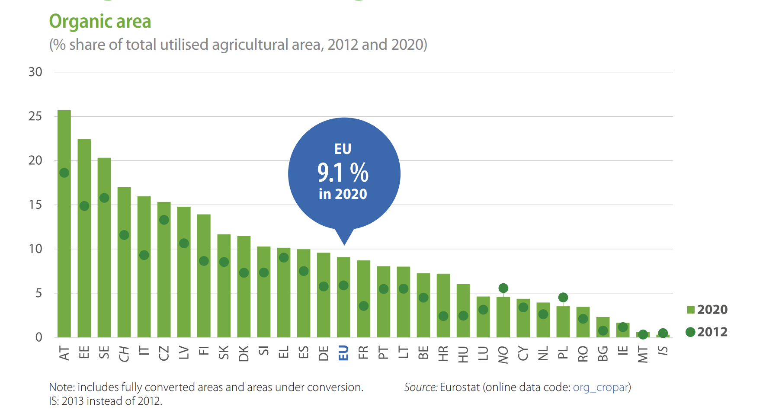
Organic Farming – sustainable farming solution
There is a varied area coverage of organic agriculture across the EU member states. Poland has reduced the share of organic areas between 2012-2020, while Ireland has had a very minimal increase. Organic farming improves health, maintains ethical standards and controls land and water pollution – all vital elements of ESG strategies.
Source: https://ec.europa.eu/eurostat/documents/15216629/15559935/KS-FK-22-001-EN-N.pdf/1cb9d295-6868-70e3-0319-4725040cfdb8?version=3.0&t=1670599965263

Slide 12
Water Efficiency
To improve water efficiency a strategy of rainwater capture and distribution systems can be used. These systems can be mounted on single roof agricultural buildings with an above ground rainwater, and with multiple roofs a large underground system can be used for maximum efficiency and volume of collection. ma. Large-scale water storage tanks with environmentally friendly treatment can keep the water clean and fresh for up to 6 months- meaning that it can be collected and used for periods of predicted water-stress or droughts.
ESG specific advantages include:
Saving money on water bills – where the remaining capital can be reinvested
Fast return on investment (1 – 6 years average)*
Up to 50% reduction in Water Run Off costs*
Crops and livestock prefer rainwater as it is soft water
Less mainataince required for pipes, machines and equipment due to soft water
Reduce flood risk with control and improved storage of water during heavy precipitation seasons
Source: http://www.dandhgroup.co.uk/rainwater-harvesting/ , *https://jrhwatermanagement.co.uk/solutions/rainwater-harvesting-systems/

Slide 13
Adoption of a Circular Economy
The European Environment Agency (p.11, 2014) defines the circular economy as:
“A concept that is connected to the green economy… [it] refers mainly to physical and material resource aspects of the economy — fuel, minerals, water, biomass… it focuses on recycling, limiting and re‑using the physical inputs to the economy, and using waste as a resource, leading to reduced primary resource consumption”
A circular economy strives to eliminate waste. Instead, the final result, or "waste," of one cycle serves as the product for the next, and so on. This replicates a natural regeneration cycle in which all by-products are contained within a system, evolving in function as they move through it.

Slide 14
Adoption of a Circular Economy Continued
An example of the adoption of a circular economy approach into agriculture is regenerative food production. It can improve the health of the local ecosystem as it reduces the need for pesticides which create increased pollution and health and safety concerns.
Regenerative food production is the use of organic resources from primary agricultural production to act as fertiliser. Any scraps or waste is composted and then used to improve the nutrient content of the soil for new crops, at a small or large scale. It is a free alternative to fertiliser and does not contain toxic chemicals.
Source: https://archive.ellenmacarthurfoundation.org/explore/the-circular-economy-in-detail

Slide 15
Adoption of a Circular Economy Continued
Strategies as part of regenerative agriculture (Regen Farmer, 2023) can include:
• A change to organic fertilisers
• Creating own organic fertilisers through composting or manure
• No pesticide uses
• Crop rotation
• Crop variation
• Agroforestry
• Permaculture
• Aquaculture
• Plants which increase pollination
• Perennial crops
• Maintenance of a soil food web
• Use of cover crops
Source: https://regenfarmer.com/regenerative-farm-landscape-design/

Slide 16

Adoption of a Circular Economy Continued
Due to rising funding, knowledge-sharing, and EU directives and initiatives, individuals and organisations that seek to work within a circular economy model do not need to develop these management methods on their own. Instead, they may take advantage of their growing popularity and seek out information which is already available if they wish to implement strategies in line with the EU Taxonomy.

Slide 17
Adoption of a Circular Economy Continued
Example actions from recommendations from the ‘Action in Food Waste Prevention Developed by the EU Platform on Food Losses and Food Waste include’ include:
Integration of food loss and waste reduction as part of climate action strategies and programmes by European and national public authorities, including regional and local level
Integration of food loss and waste in education and professional training through the implementation of lifelong learning in schools and on-the-job training
Improvement of resource efficiency and reduction of food losses in agriculture by improving animal health and welfare and access to innovation
Better forecasting for raw material buying and improvement of date marking practices and consumer understanding of date marking and other relevant food information jointly with stakeholders of the company or organisation by food manufacturers
Motivation and engagement provided by relevant agricultural trade associations to adopt measures against food waste in their operations
Source: https://food.ec.europa.eu/system/files/2021-05/fs_eu-actions_action_platform_key-rcmnd_en.pdf

Slide 18
Agriculture as a means of increasing and redistributing food production as a means of reducing poverty
Around 10% of the global population (roughly 800 million people) continues to go hungry each day
The number of people affected by hunger globally rose to 828 million in 2021, an increase of about 46 million since 2020 and 150 million since the outbreak of the COVID-19 pandemic
Nearly 670 million people (8% of the world population) will still be facing hunger in 2030 – even if a global economic recovery is taken into consideration.
By 2050, the global population will increase by a further 1.8 billion people; meaning we will need 70% more food than what is consumed today.
Social and governance aspects of ESG can aid in helping reducing food poverty at a community scale
Source: https://www.who.int/news/item/06-07-2022-un-report--global-hunger-numbers-rose-to-as-many-as-828-million-in-2021

Slide 19
Health and Safety concerns in Agriculture
Machinery routine checks, training, certification
Work related weather health hazards such as heat strokes or hypothermia
Appropriate uniform- clothing, helmets, gloves, goggles, boots
Natural hazard - provisional and direct responses by employers and employees such as floods, tornadoes, earthquakes, volcanic eruptions, storms
Management of health and safety at work regulations (MHSWR 1999)
Protection against animal disease or fungus which can be virally or bacterially transmitted to humans in the workplace

Slide 20

Health and Safety concerns in Agriculture Continued
All health and safety concerns must abide with Article 153 of the EU OSHA directive safety and health at work. As all member states are free to adopt the rules into national law, these can vary across EU Member states, therefore some may be less strict than others.
This does not mean a company should abide just to the minimum legislative health and safety practises. We encourage wide application of health and safety rules into the workplace to highlight this in ESG.

Slide 21
Community Agricultural Practices
Community agricultural practises are a great idea for improving the social aspects of your company. There are many strategies which can be integrated into something for the community, such as a ‘green thumb club’ or training days.
Focus points can include:
Using native plant species to increase pollinator presence
Composting
Vegetable and fruit growing
Source: https://extension.usu.edu/sustainability/research/community-agriculture-concepts-models-impacts#:~:text=Defining%20Community%20Agriculture,to%20food%20in%20their%20communities.

Slide 22
Community Agricultural Practices Continued
Advantages of community agriculture include:
Access to healthy foods like fruits and vegetables, especially in low-income areas.
Individuals and households who participate in such programs are over three times more likely to consume fruits and vegetables at least five times a day than people without a gardening household member (Alaimo et al., 2008)
Place to connect to culture by providing an area to express their ethnic identity and grow specialty food items not available elsewhere. This can lead to an enhanced sense of well-being (Milburn and Vail, 2010).
Community engagement
Environmental stewardship education
Source: https://extension.usu.edu/sustainability/research/community-agriculture-concepts-models-impacts#:~:text=Defining%20Community%20Agriculture,to%20food%20in%20their%20communities.

Slide 23
Agriculture in the workplace
Workplace Volunteering or Employer-supported volunteering (ESV) gives employees the opportunity to volunteer during working hours. Agricultural workplace volunteering programmes can help form a bridge between companies, their employees and the wider community.
Benefits for employers include employee development. Employees can develop their soft and hard skills through agricultural action. Agricultural companies might wish to think about programmes which they can set up in their workplace for internal and external users. It can improve communication, teamwork, and understanding of the local community.
Source: https://www.cipd.co.uk/knowledge/strategy/volunteering/employer-supported-factsheet#gref

Slide 24
Agriculture in the workplace Continued
Volunteering gives employees the chance to give back to society based on current issues they feel passionate about. They may develop their leadership and interpersonal skills, gain increased depth in their knowledge confidence, creativity, and a morale boost as they feel a senses of purpose.
Community organisations often have low budgets which is why they value the work of volunteers, particularly with higher education and work experience which they can share with the organisation.
Agriculture in the workplace can include ESV in the agricultural sector, or the agriculture companies providing community programmes.
Source: https://www.cipd.co.uk/knowledge/strategy/volunteering/employer-supported-factsheet#gref

Slide 25
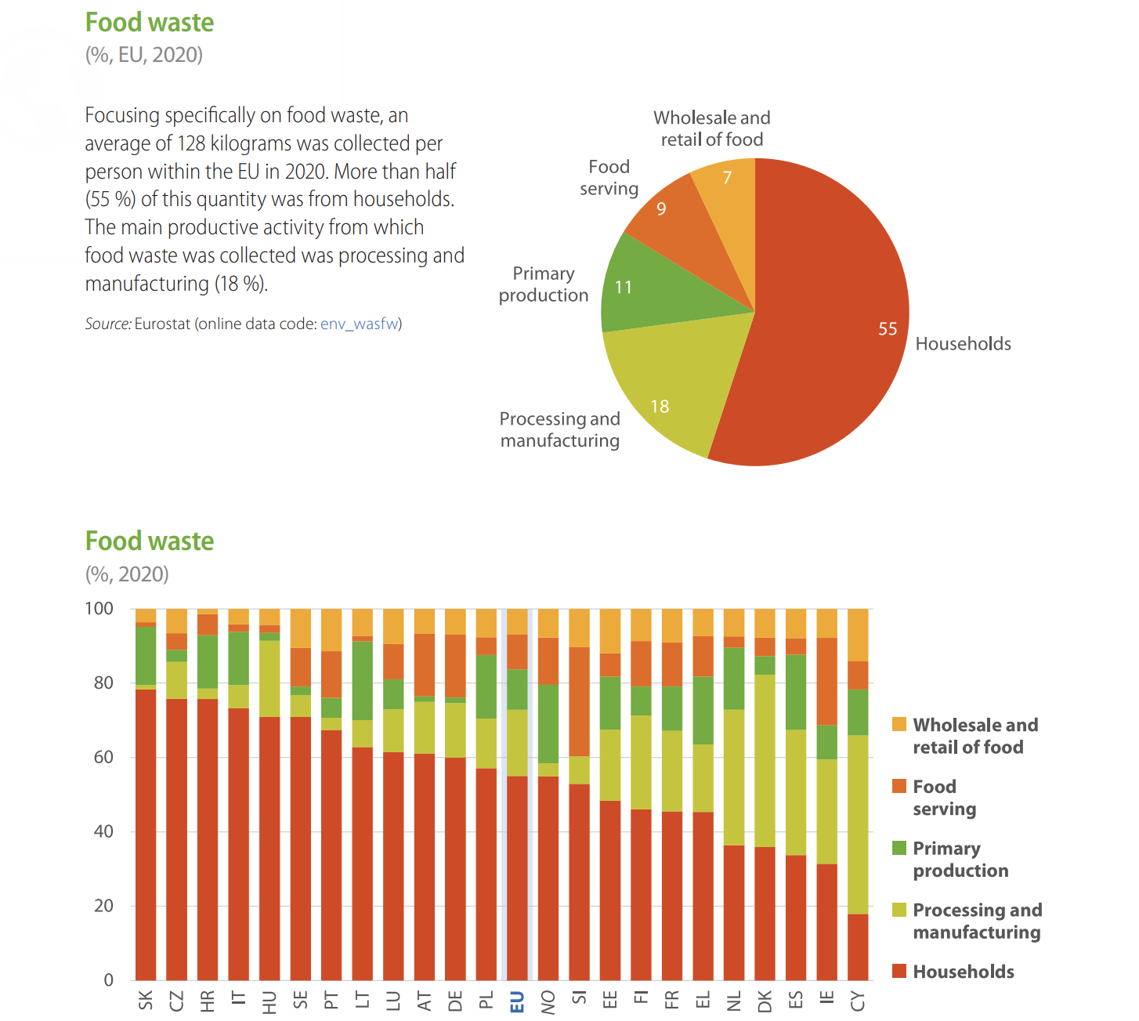
Education
As part of CSR and ESG strategies, the agricultural sector has a duty to educate its shareholders, employees and companies affiliated with the supply chains and productions on climate change impacts. This includes food waste. On average in the EU, 55% of the food wasted can be attributed to households – this shows individuals should be educated. Employers can have a big part in this for example encouraging soups made from vegetables left over from the company canteen and kitchen. Each EU country is different therefore each strategy will be unique.

Slide 26
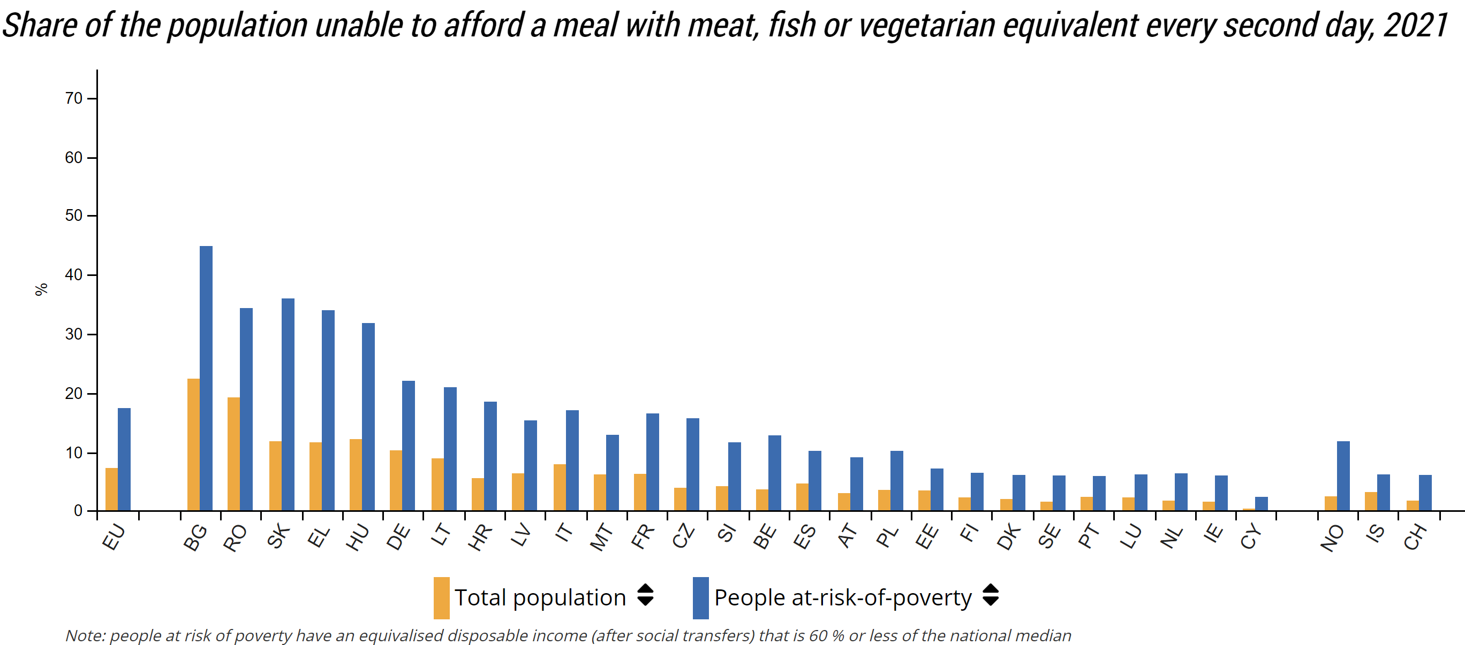
Food poverty in the EU
Agricultural sectors create strategies to prevent this such as partaking in government schemes for the people at risk of poverty, improving food distribution such as food bank donations or giving higher than minimum wage for its employees.
Source: https://ec.europa.eu/eurostat/web/products-eurostat-news/-/ddn-20220225-1

Slide 27
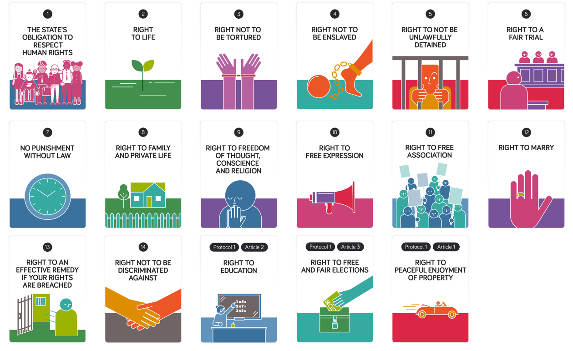
Human Rights and Labour Standards
Human and child labour
Modern Day Slavery
Cash in hand
Right to an education and training
Discrimination
Remuneration
These are just a few examples of the most commonly abused human rights in the agricultural sector. Some farming institutions force vulnerable people to carry out tasks such as fruit picking, withholding pay, working long hours and being subject to abuse and lack of health and safety. It is everyone’s duty to watch out for any violations and report them to the police. Transparency and disclosure is at the key of company governance and managers as well as stakeholders after responsible in publishing this information.
Image source: https://research.senedd.wales/research-articles/a-quick-guide-to-human-rights-in-wales/

Slide 28
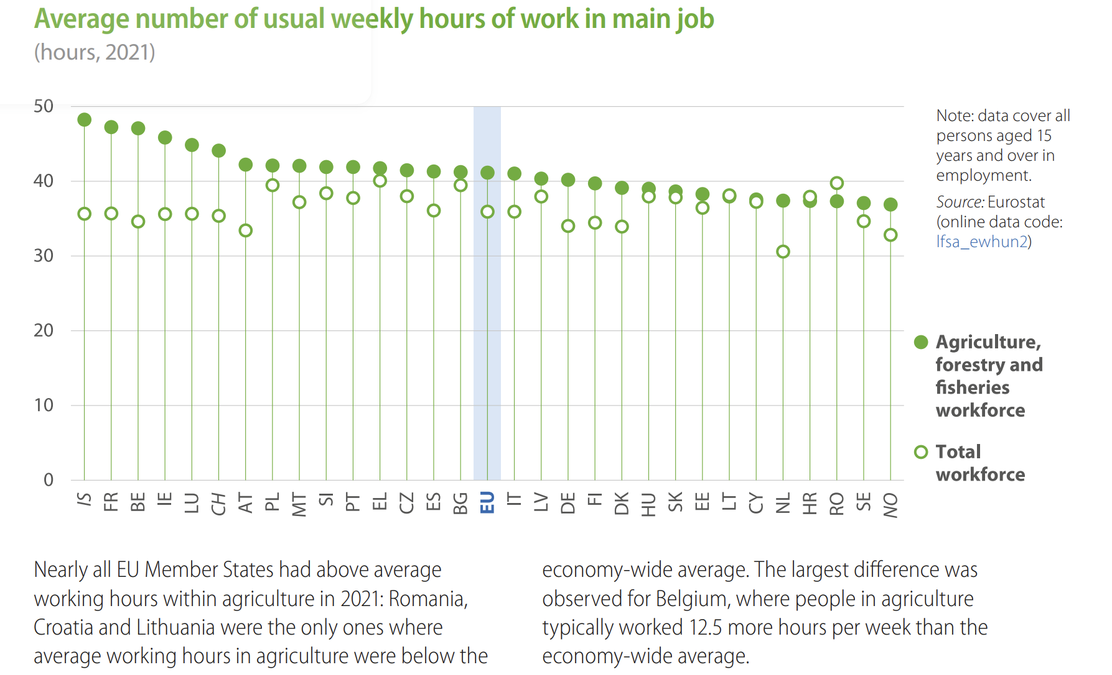
Average hours worked in the Agricultural sector
All except three member states (Romania, Croatia and Lithuania) had above average working hours performed within the agricultural sector in 2021 when compared to the total workforce average.
This highlights the need for extra attention to the Social and Governance policies in agricultural settings to maintain ethical standards of work, particularly in medium and large sized enterprises with a higher number of employees.
Source: https://ec.europa.eu/eurostat/documents/15216629/15559935/KS-FK-22-001-EN-N.pdf/1cb9d295-6868-70e3-0319-4725040cfdb8?version=3.0&t=1670599965263

Slide 29
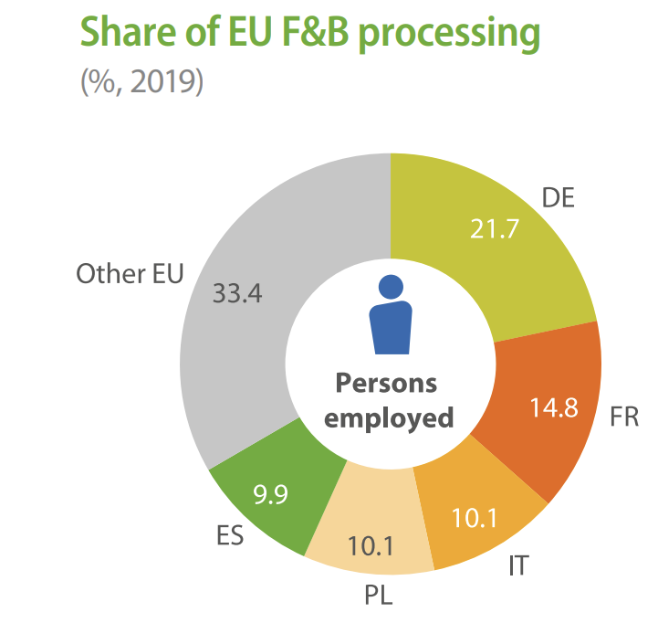
Food and Beverage processing in the EU - statistics on share of people employed
Not every EU country has the same sized agricultural sector. Germany and France together have more people employed in food and beverage processing than the rest of the EU countries after the top five are taken away (36.5% vs 33.4%).
Hence, ESG activities in this will need wider implementation and concern in Germany, France, Italy, Poland and Spain – which is 2/3 of the EU food and beverage employees in processing.

Slide 30
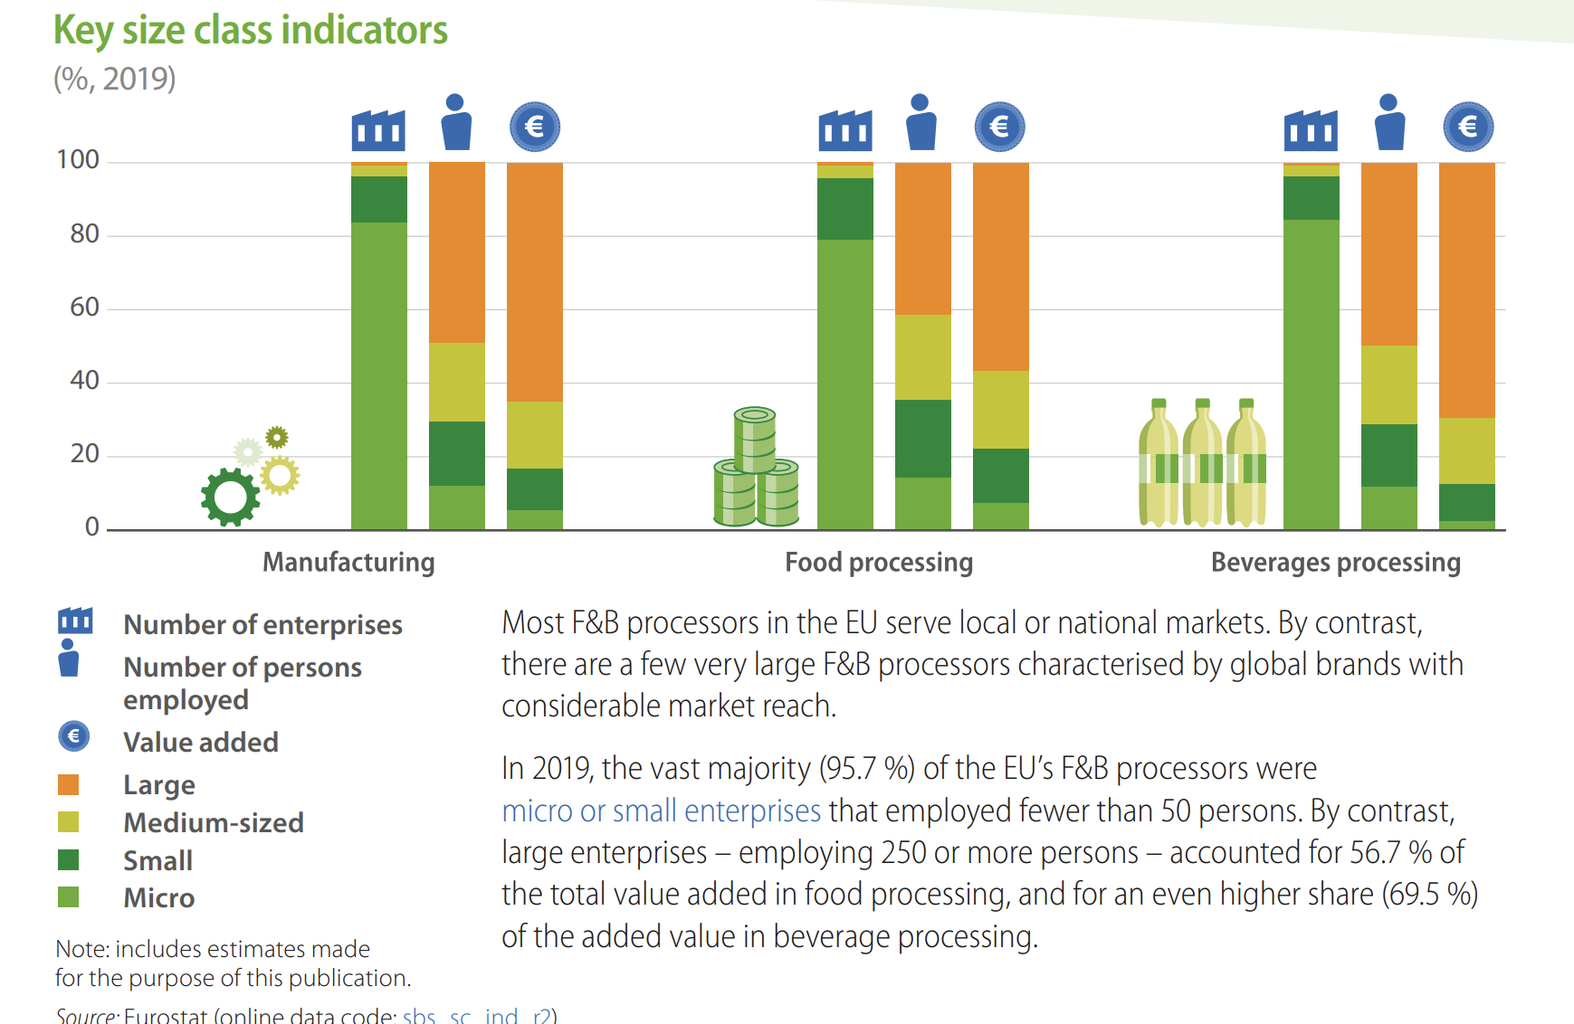
Food and Beverage processing in the EU - statistics on size of enterprise involved
As of 2023 only large enterprises need to adopt the EU Taxonomy ESG reporting, however by 2026 all micro, small and medium sized enterprises will also need to provide a non-financial CSR report as per the European Commission.
In the EU, the majority of employees and economic output is from large enterprise, however micro enterprises make up around 80% in all three processing types as shown on the graph – meaning all sizes of organisations have a duty to ESG practise implementation.
Source: https://ec.europa.eu/eurostat/documents/15216629/15559935/KS-FK-22-001-EN-N.pdf/1cb9d295-6868-70e3-0319-4725040cfdb8?version=3.0&t=1670599965263

Slide 31
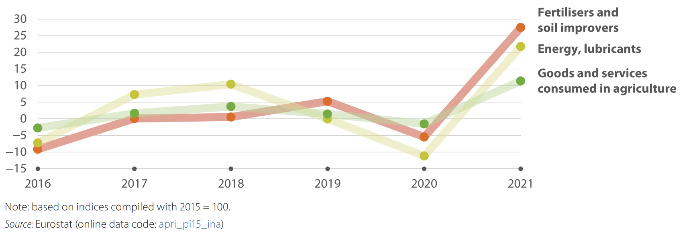
ESG in Agriculture – not all changes require large amounts of economic input
In agriculture the highest price input for 2021 was fertilisers and soil improvements. As mentioned previously, one method to reduce this cost is organic composting
There was a rapid increase in input prices for the EU’s agricultural industry between 2020 and 2021, as the overall price of goods and services rose 11.4 %, fertilisers and soil improvers rose by 27.5 % in 2021, and energy and lubricants rose by up 21.8 % in 2021 compared to 2020.
This highlights the need for ESG reporting as companies within agriculture will make environmental changes such as reduced energy uses, which will decrease the cost pressures they face. Also, companies which show to be aligning with the EU Taxonomy particularly well will be more likely to receive EU funding and investment from external sources.
Source: https://ec.europa.eu/eurostat/documents/15216629/15559935/KS-FK-22-001-EN-N.pdf/1cb9d295-6868-70e3-0319-4725040cfdb8?version=3.0&t=1670599965263

Slide 32
WORKSHOP DAY 2
THANK YOU
28 March 2023 Warsaw, Poland

