Slide 1
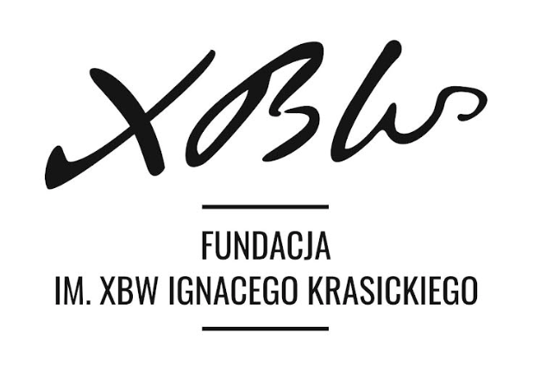


WORKSHOP DAY 1
Cultural Diversity and Cultural Conflict in Workplaces as part of ESG strategy
- Cultural diversity at the workplace in the EU
27 March 2023, Warsaw, Poland

Slide 2
Introduction

Slide 3

Purpose of the Presentation
The goal of this short presentation is to grasp a soft understanding of multiculturalism - cultural conflict mediation in workplaces and how they can be managed and executed with respect to employees' religious and cultural differences and also to provide an overview of the importance of cultural diversity in the workplace.
The audience will gain an understanding of the benefits of cultural diversity in the workplace, the various types of cultural conflicts that can arise, and the strategies that can be used to effectively manage and mediate these conflicts through this presentation.
Finally, the presentation aims to provide practical recommendations and insights to employers in the European Union and Poland on how to create a more inclusive and harmonious workplace that values and respects their employees' cultural diversity.

Slide 4

Definition of Multiculturalism
The coexistence of multiple cultures in a society, workplace, or organization is referred to as multiculturalism. The European Union (EU) has a diverse population, with people from all over the world living and working together. Cultural conflict can arise as a result of differences in values, beliefs, and practices, which are exacerbated by diversity.
"Multiculturalism refers to the existence of difference and uneven power relations among populations in terms of racial, ethnic, religious, geographical distinctions, and other cultural markers that deviate from dominant, often racialized, "norms," according to John Clayton in the International Encyclopaedia of Human Geography (Second Edition), 2020.
https://www.sciencedirect.com/topics/social-sciences/multiculturalism

Slide 5
Reasons why Multicultural Education is Essential in our Diverse World
The number of international immigrants skyrocketed from 153 million in mid-1990 to 271 million in mid-2019 (United Nations, 2019), which leads to modern societies becoming far more culturally diverse.
Hence, multicultural education is more crucial than ever in breaking down stereotypes, and intolerance; ensuring our new citizens feel welcome and included in their newly adopted society.
Six reasons why multicultural education is essential are;
Assist cultural groups in feeling included, and therefore feeling they belong in the school community. This, of course, makes immigrant and non-white students more motivated and engaged to learn.
Gain accurate representation and knowledge of cultural groups.
Promote intercultural interaction and harmony in a school setting.
Mindset of critical thinking on current social issues surrounding cultural diversity.
Advanced equity in education.
Promote multiculturalism and multicultural education amongst teachers and educators.
https://culturalinfusion.org.au/6-reasons-why-multicultural-education-is-essential-in-our-diverse-world/

Slide 6
Cultural Diversity in Workplaces

Slide 7
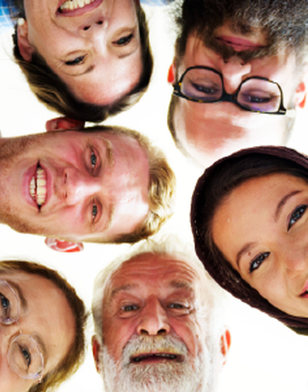
Overview of Cultural Diversity
Cultural diversity refers to the variety of cultures, beliefs, practices, and languages within a society or a group of people. It is the coexistence of different cultural backgrounds and ways of life. Cultural diversity can exist at different levels, including within a country, a region, a city, a neighborhood, or even within a family.
It is shaped by various factors, such as history, migration, globalization, and technology. It can manifest in different forms, such as art, music, food, religion, language, and traditions. Cultural diversity is not only a source of social richness and creativity, but it can also pose challenges and opportunities for individuals and communities, such as issues related to integration, social cohesion, and intercultural communication.
It is recognized and promoted as a value and a human right by many international organizations, such as UNESCO and the United Nations. It is considered an essential component of sustainable development and a means to achieve social, economic, and political progress.
https://www.pewresearch.org/fact-tank/2016/07/12/in-views-of-diversity-many-europeans-are-less-positive-than-americans/ft_16-07-11_eu-usdiversity_overall/

Slide 8
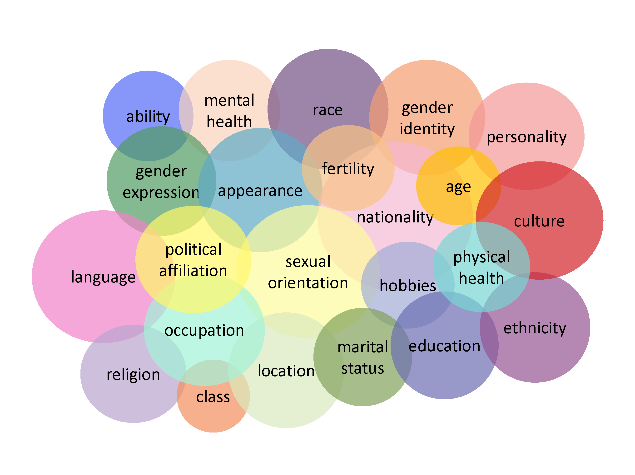
Why Diversity and Inclusion matters in Work Places
Diversity Council Australia (DCA) describes diversity as being the mix of people in your organization, and inclusion as being about creating a workplace environment or culture that enables that mix to work – both for organizations and employees.
Diversity can be multicultural diversity, religious or faith-based, diversity of experience, socioeconomic diversity, gender identity, sexuality, age, identifying as Aboriginal or Torres Strait Islander, disabilities (including disabilities that are not visible), and a wide range of other demographics. Whilst it’s not a given, surely there are advantages in bringing together people with different views, lived experiences, or myriad perspectives?
In Diversity Still Matters (May 2020), McKinsey lists five key imperatives for championing D&I initiatives:
Winning the war for talent and holding on to top talent
Improving the quality of decision-making and enhancing problem-solving skills
Increasing customer insight and innovation – diverse teams are more innovative and stronger at anticipating shifts in consumer needs and patterns
Driving employee motivation and satisfaction – companies committed to D&I are about 75% more likely to report a pro-teamwork leadership culture
Improving a company’s global image and license to operate – companies that maintain (or increase) their focus on D&I during the downturn are likely to avoid the risk of being penalized in its aftermath
https://transearch.com.au/why-diversity-inclusion-matters-in-organisational-culture/

Slide 9
Benefits of Cultural Diversity in Work Places
Boosts Creativity & Innovation:
Diversity allows different ideas, perspectives, and opinions to emerge out of the workforce.
It helps to look at the situation from all possible angles that helps to bring out something unique.
Improves Problem-Solving & Decision-Making Skills
People from diverse cultures can introduce positive new beliefs and practices that allow the employees to look at the situation with a growth mindset.
The broader viewpoints and perspectives help resolve complex issues with ease while simultaneously forming business strategies.
Cultural diversity can boost cognitive flexibility as employees get familiar with different cultures and their importance for business..
Cater to Best Talent Pool
Research shows that around two-thirds of employees seek diversity and inclusion as key factors for choosing a company.
Cultural diversity allows people from all cultures and backgrounds to feel inclusive and heard. Therefore, cultural diversity would magnetize highly talented people to join the organization.
High Happiness Index & Job Satisfaction
An inclusive environment allows employees to feel respected, heard, and appreciated for their contributions.
It motivates them to work hard and with full excitement as they feel safe within the organization.
Ease of Going Global & improving Brand Reputation
Culturally diverse employees allow the organization to penetrate foreign markets through their shared cultures and experiences.
It gives a competitive advantage with more customer appeal, investors' trust, and the ability to negotiate with foreign firms.
Cultural diversity sets the organization apart in the industry with unique styles of conduct and a sense of inclusivity.
Higher Employee Engagement
A culturally diverse place is a hub for improving interpersonal skills and knowing more about other cultures.
It bridges the cultural gap and helps to foster personal connections among employees that help them connect better among themselves.
Higher interpersonal connections boost teamwork and cooperation with one another.
https://www.getimpactly.com/post/importance-of-cultural-diversity-in-the-workplace

Slide 10
Cultural diversity in the EU
The European Union (EU) is a diverse and multicultural region comprised of 27 member states, each with its own language, customs, and traditions. As a result, the EU is home to a diverse range of ethnic, cultural, and religious groups, each with its own unique identity and set of values.
Cultural diversity is an essential component of the EU's identity, as enshrined in the EU's founding principles, which emphasize the importance of respecting and promoting diversity and cultural heritage. The EU also recognizes the value of cultural diversity in fostering social cohesion, encouraging innovation and creativity, and bolstering economic growth.
The EU has taken a number of steps to promote cultural diversity and protect minorities' and marginalized groups' rights. The European Union, for example, has established a number of cultural programs and initiatives, such as the European Capital of Culture program, which aims to promote cultural exchange and cooperation across the EU.
The EU has also implemented a number of policies and initiatives to help immigrants and minorities integrate into European society. These policies include initiatives to combat discrimination and promote equal treatment, as well as policies to promote language learning, job training, and social inclusion.
Overall, cultural diversity is an important part of the EU's identity and shapes its social, political, and economic landscape. The EU's commitment to promoting and protecting cultural diversity has aided in the development of a sense of unity and shared values among its member countries, while also celebrating the richness and diversity of European cultures.
https://www.tandfonline.com/doi/full/10.1080/1369183X.2018.1550150

Slide 11
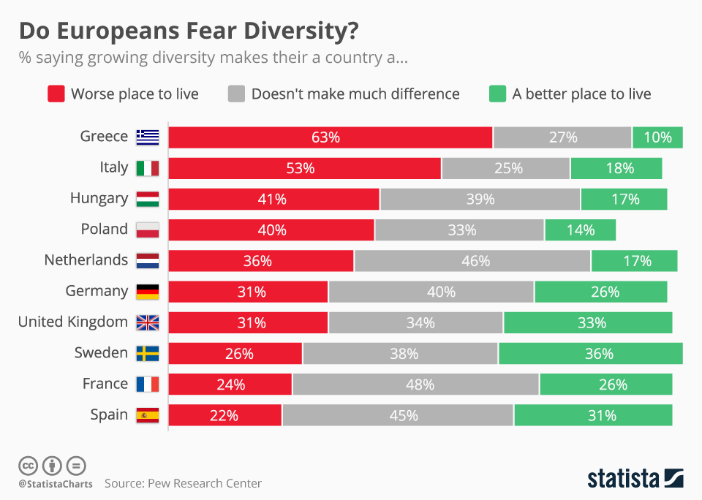
Perception of Cultural Diversity in Europe
Polish understanding of multiculturalism differs significantly from that in other European countries, as it is mainly based on historical memory, referring to the period of Noble’s democracy and the political practice of the Commonwealth of Poland and Lithuania in the 16th-17th century.
The growing standard of living and Polish membership in the EU makes Poland more attractive for immigrants from the so-called Third Countries, which does not affect real situation of immigrants’ functioning within the Polish state, even though there are many efforts made by various authorities towards legislative changes in the spirit of the guidelines imposed on Poland by the European Union.
Poland's religious and cultural diversity is a result of its unique historical and geographic position in central Europe. Despite its diverse population, the country has managed to maintain a strong national identity and cultural heritage while celebrating its rich cultural diversity
https://www.statista.com/chart/5247/do-europeans-fear-diversity/

Slide 12
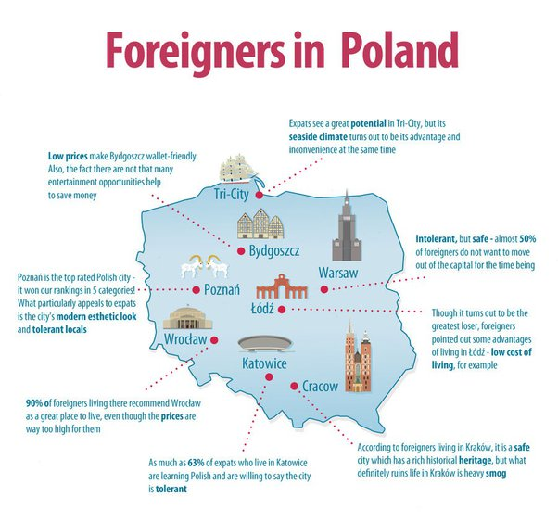
Multiculturalism in Polish Workplace
Poland, unlike Western perception, is already more multicultural and diverse than you would expect. Over 5% of the population is from a different culture.
At the end of 2019, there were over two million foreigners living in Poland, making up around 5% of the country’s population, according to preliminary findings from a study by Statistics Poland (GUS), a government agency.
Poland has in recent years experienced levels of immigration unprecedented in the country’s history and among the highest in the European Union. In 2017 and 2018, the last two years for which EU-wide data are available, Poland issued more first residence permits to immigrants from outside the bloc than any other member state.
Data from Poland’s labor ministry showed that in 2019 there was a further 35% increase in the number of work permits issued to immigrants from outside the EU. However, precise figures for the overall number of immigrants in the country have been hard to come by.
The new study, the first of its kind published by GUS, combined data from nine different state sources relating to employment, healthcare, and education, as well as from the government’s Office for Foreigners and PESEL (state identity database) records, reports Business Insider Polska.
https://www.quora.com/Will-Poland-become-more-multicultural-in-the-future-like-Germany-or-the-UK

Slide 13
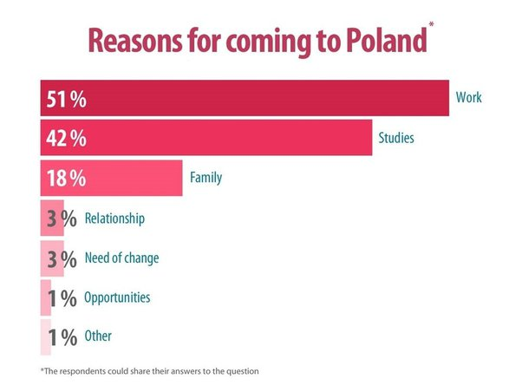
Deepening Cultural Mediation in Workplaces in Poland
Poland has seen an increase in the number of foreigners working and living in the country, which has led to greater cultural diversity in the workplace. Cultural mediation can help bridge the gap between different cultures and facilitate communication, leading to a more harmonious work environment.
Deepening cultural mediation in the workplace in Poland due to the
growing diversity can lead to a more inclusive, productive, and harmonious work environment, which benefits both employees and employers.

Slide 14
Managing and Executing Cultural Diversity in the Polish Workplace

Slide 15

Recommendations for Managing Cultural Diversity in the Workplace
Diversity management encapsulates diversity and inclusion in a company—from establishing hiring practices and outreach efforts to the development of corporate standards and diversity metrics to the communication and coordination of continuing diversity education and training for the entire organization.
According to GlobeSmart, a simple definition of diversity management can be something like this; “the coordinated, determined effort of leadership and management throughout an organization to bring in employees from all walks of life and diverse backgrounds into various roles”.
https://www.globesmart.com/blog/diversity-management-prioritize-inclusion-and-manage-diversity-in-the-workplace/

Slide 16
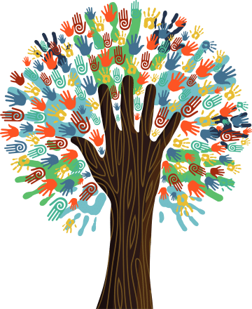
Recommendations for Managing Cultural Diversity in the Workplace. Cont.
Examine Your Policies to Fight Systemic Inequality: Creating a more inclusive organization takes effort. But no matter what actions an organization takes, it must also be aware that its policies may be promoting systemic inequality. To counter this, audit your policies. Ensure that your family-leave policy is supportive of LGBTQ parents as well as traditional couples. “Remote-work policies are another point of consideration for building a truly inclusive work environment.
Create a Culture of Empathy and Forgiveness: Leaders must have the self-awareness to know that they’ll have certain blind spots when it comes to their employees and their employees’ experience. For example, maybe a leader doesn’t know the pronouns an employee prefers. But what’s most important in these situations is that leaders be aware of their blind spots — and that they work to solve them. “I like to look at it as mirrors, windows, and doors,” Harris says. “You look in the mirror and that’s self-awareness. You look out the window and you get perspectives from others to try to get a clue about your blind spots.”
Ensure Leadership Is Aligned with Your Goals: Be sure that leadership is briefed and on board with your plans as you look to address issues of diversity in your organization. Cappellanti-Wolf says. Additionally, leadership’s behavior and actions will serve as examples for all levels of the organisation and set the tone for what’s expected of employees.
https://talentculture.com/7-tips-to-manage-a-diverse-workforce/

Slide 17

Strategies for Managing Diversity in the Polish Workplace
Here are some workable and realistic strategies that can be adopted for SMEs and large-scale companies
Prioritize Inclusion Processes and Policies: Make diversity and inclusion efforts a priority—and stick to them. Never let your inclusion processes and policies become dusty old statements written in long-forgotten employee handbooks; keep them active, keep them top-of-mind, and change them as the times (and the environment) demand.
Determine Initiatives: Avoid the "one size fits all" solution for your diversity management efforts. Determine the initiatives that your organization will undertake. This process will involve stakeholders throughout the organization—from the top on down. Meet with leadership and employees to determine what is working, what isn’t, and what initiatives you should start on for an authentic management effort.
Identify Resources for Diversity and Inclusion Programs: Resources such as a dedicated D&I employee in the organization (as many organizations have these days) or will it be a part of your HR efforts, budget consideration to enable management for diversity efforts, invest in building out employee resource groups, diversity, and inclusion-focused online resource, or having the services of a consultant to sit down with key stakeholders and plot out how to best develop the tools needed to enable your diversity management programs
Be Intentional: Set Diversity Goals and Accountability for Change: Be intentional with your efforts and set concrete diversity goals throughout the organization based upon optimistic (but realistic) benchmarks, and hold your organization accountable.
Seek Out Different Mindsets
Set up Inclusion and Diversity Training
Build a Diverse Leadership Team
https://www.globesmart.com/blog/diversity-management-prioritize-inclusion-and-manage-diversity-in-the-workplace/

Slide 18
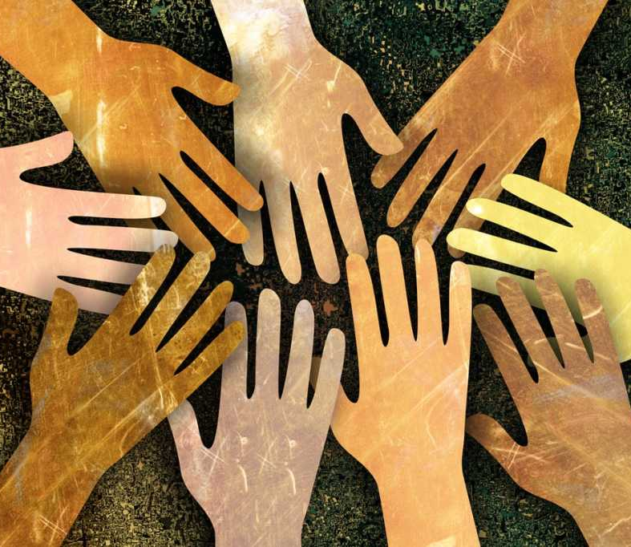
Best Practices for Executing Cultural Diversity In Workplaces
Set measurable goals and then measure them
Fix your inclusion problems before you recruit
Encourage people to tell their story
Make leaders accountable to your DEI goals
Create ways for people to say what’s wrong
Examine the rules and assumptions that define your culture
Give the DEI leader a seat at the table
https://getintheknow.ca/best-practices-awards/cultural-diversity-best-practices/

Slide 19
Cultural Conflict Mediation in the Workplace

Slide 20
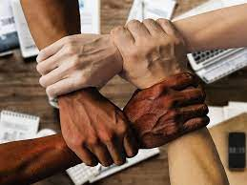
Understanding Cultural Conflict Mediation
Mediation of cultural conflicts is an important aspect of promoting diversity and inclusion in the EU workplace. It contributes to the creation of a harmonious and respectful work environment in which employees of all cultural, religious, and social backgrounds can effectively collaborate.
Religious, cultural, and social conflict mediation in the EU workplace entails resolving conflicts and differences that arise between employees or groups of employees from different cultural, religious, or social backgrounds. The goal of cultural conflict resolution is to foster respect for diversity, better communication, and a harmonious workplace environment.
Differences in communication styles, attitudes toward time management, dress codes, dietary requirements, and holidays are some examples of cultural conflicts that may arise in the EU workplace

Slide 21

Types of Cultural Conflicts in Work Places.
Religion: Religion is a core cultural characteristic of many people's identity and it can affect perceptions, intentions as well as work behavior. Different beliefs and ethical principles can cause conflict among co-workers or even lead to religious discrimination.
Sexual Orientation and Gender Identity: Workplace issues due to sexual orientation are very common. LGBTQ communities are often subject to harassment, hostility, biased jokes, or inappropriate questionsº that lead to employee disengagement. In fact, many workers hide their identities for fear of discrimination.
Education: The educational level is also part of people's background and affects how they fit into workplace environments. Differences in educational experiences mean different approaches to problems and situations in the workplace. This can cause conflicts among employees working on the same projects but implementing certain methodologies based on their own education.
Generation: Depending on their generation, employees may also have different outlooks, values, and ideas about business and professionalism. For example, older generations tend to have long-term career expectations, making them more loyal to an employer. On the other hand, Millennials tend to have a higher value of work-life balance and consistently seek growth opportunities, so they are most likely to move on to another company or higher positions.
https://www.easyllama.com/blog/cultural-issues-in-workplace-environments/

Slide 22

Some Strategies for Managing Cultural Conflicts.
Encourage Cultural Sensitivity and Awareness: Employees should be encouraged to learn about different cultures and religions. Train employees about cultural differences and encourage them to be respectful and sensitive to these differences through training programs.
Encourage Communication: Make your workplace open and inclusive so that employees can freely communicate with one another. If employees are unsure about cultural practices or beliefs, encourage them to ask questions and seek clarification.
Be Respectful: Create a respectful environment in which all employees feel valued and included. Encourage the use of non-discriminatory language and behavior, and make certain that all employees are treated with dignity and respect.
Create an Inclusion Culture: Establish a workplace culture that values diversity and inclusion. Celebrate cultural and religious holidays and events, and foster an atmosphere where all employees feel welcome and included.
https://www.easyllama.com/blog/cultural-issues-in-workplace-environments/

Slide 23
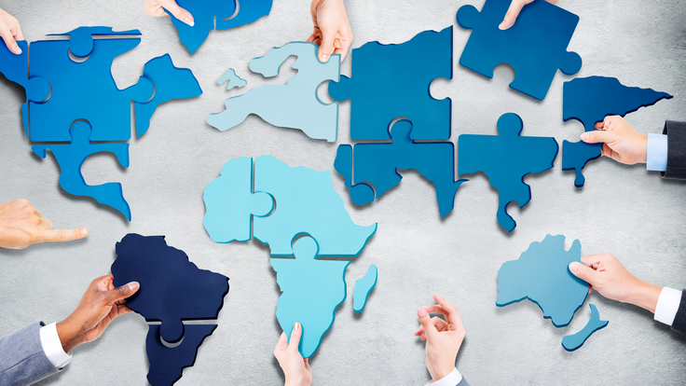
Cultural Mediation Programs in the EU.
Creative Europe is the EU's funding program for the cultural and creative industries. The program funds cross-border cooperation projects, cultural events, and artist and cultural professional mobility. https://ec.europa.eu/programmes/creative-europe/.
Erasmus+ is the European Union's program for education, training, youth, and sport. The program promotes student, teacher, and youth worker mobility, as well as collaborations between cultural and creative organizations.
European Capitals of Culture: The European Capitals of Culture is a program of the European Union that aims to promote cultural diversity and cooperation across Europe by designating a different city each year as the European Capital of Culture. The program has been running since 1985 and has contributed to the development and promotion of European cities and their cultural heritage. https://ec.europa.eu/programmes/creative-europe/actions/capitals-culture_en.
Europeana is a digital platform that allows users to access millions of digitized cultural heritage objects from across Europe. The platform's mission is to promote digital cultural heritage and make cross-border access to cultural resources easier. www.europeana.eu
Council of Europe: The Council of Europe is an international organization that promotes human rights, democracy, and the rule of law. They have a program called Intercultural Cities, which aims to promote cultural diversity and social cohesion in urban areas. Their website is www.coe.int/en/web/interculturalcities/home..

Slide 24
Conclusion

Slide 25

Summary of Key Findings
Cultural conflict mediation involves resolving disputes between individuals or groups with different cultural backgrounds. The key findings in cultural conflict mediation are:
Acknowledging cultural differences: Cultural differences play a significant role in conflicts. Acknowledging and understanding the differences in values, beliefs, and practices is an essential step in resolving cultural conflicts.
Active listening: Active listening is crucial to cultural conflict mediation. It helps the mediator understand the perspective of each party and identify the underlying causes of the conflict.
Respect and empathy: Respecting and empathizing with the cultural differences of each party is essential for successful conflict mediation. A mediator who understands the values and beliefs of each party can help them find common ground and work towards a resolution.
Use of language and communication: Communication is crucial in cultural conflict mediation. Using clear and appropriate language that each party understands can help prevent misunderstandings and build trust.

Slide 26
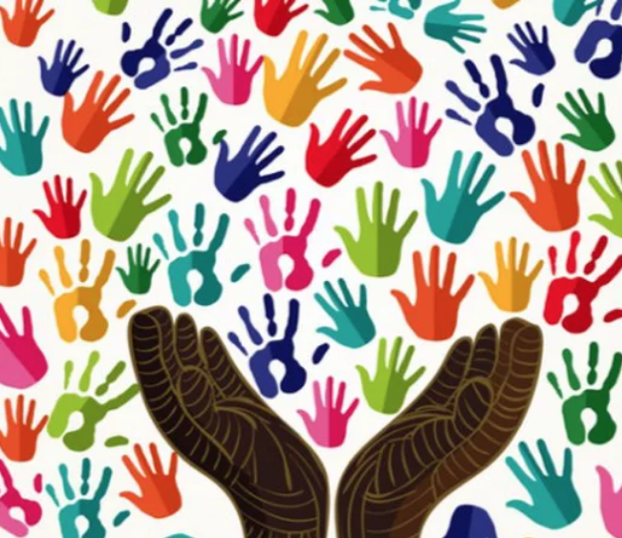
Recommendations for Managing Cultural Diversity in the Workplace
Stop Thinking of Diversity as a Buzzword: HR is full of buzzwords these days, but diversity isn’t one of them — nor should it be treated as one. Instead, remember that building a diverse and inclusive organization is something you must work on every day, just as your sales team hustles for leads and your accounting team keeps the books in order.
Make Diversity Part of Your Hiring Process: Try auditing your hiring process to ensure that you’re interviewing a diverse slate of candidates. “It starts at the hiring process,” Cappellanti-Wolf says. If you want to show that you’re serious about building a more diverse organization, you have to look critically at how you assess and hire candidates.
Build Connections to Create Talent Pipelines: It’s enormously important to building internal talent pipelines for your organization, and ensuring that you have standards in your hiring process for interviewing diverse candidates is an important step toward creating a more inclusive business and culture.
https://talentculture.com/7-tips-to-manage-a-diverse-workforce/

Slide 27

Summary of Key Findings Cont.
Creativity and flexibility: Mediators need to be creative and flexible in finding solutions to cultural conflicts. They should be able to adapt to the cultural context and come up with solutions that are acceptable to all parties involved.
Addressing power imbalances: Power imbalances can exacerbate cultural conflicts. Mediators should be aware of power dynamics and work to ensure that all parties have an equal voice in the mediation process.
Education and training: Education and training in cultural awareness and conflict resolution skills are essential for effective cultural conflict mediation. Mediators should have a deep understanding of the cultural backgrounds of the parties involved and the skills necessary to facilitate a successful mediation process.

Slide 28
WORKSHOP DAY 1
THANK YOU
27 March 2023, Warsaw, Poland

