Slide 1

IT IS TIME TO SET YOUR GOALS
FOR YOUR LIFELONG LEARNING PROCESS

Slide 2


Slide 3



Slide 4

AND WHAT IS YOUR ANSWER?

Slide 5
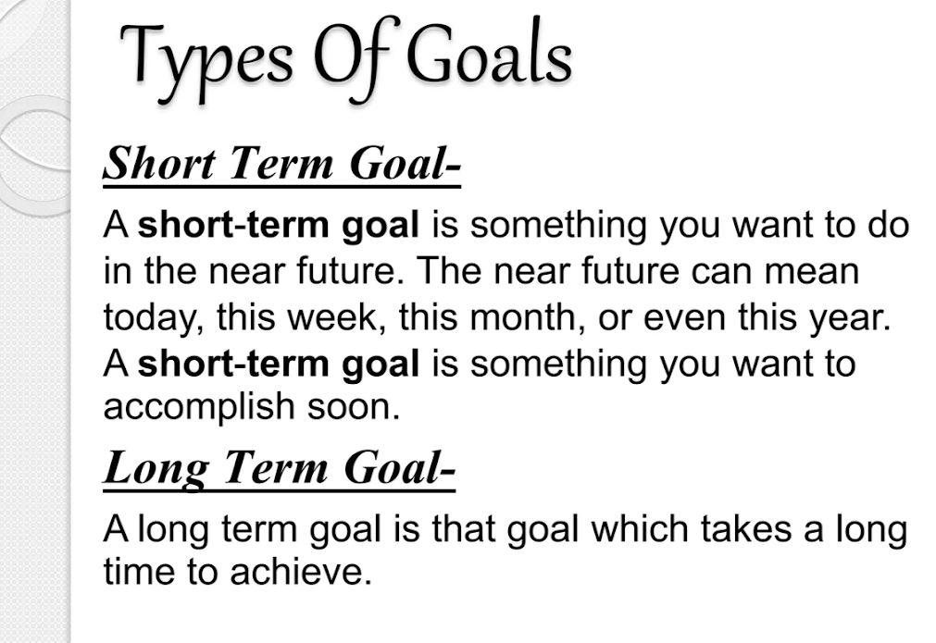

Slide 6
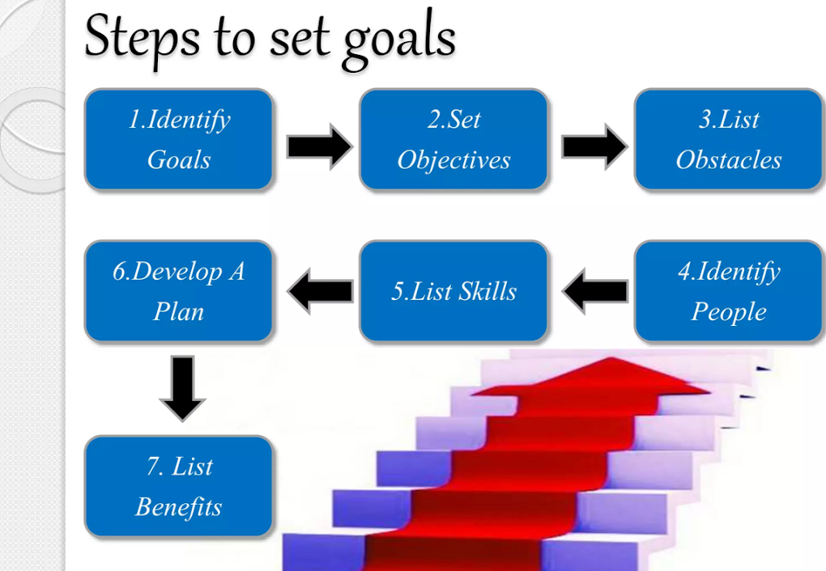

Slide 7
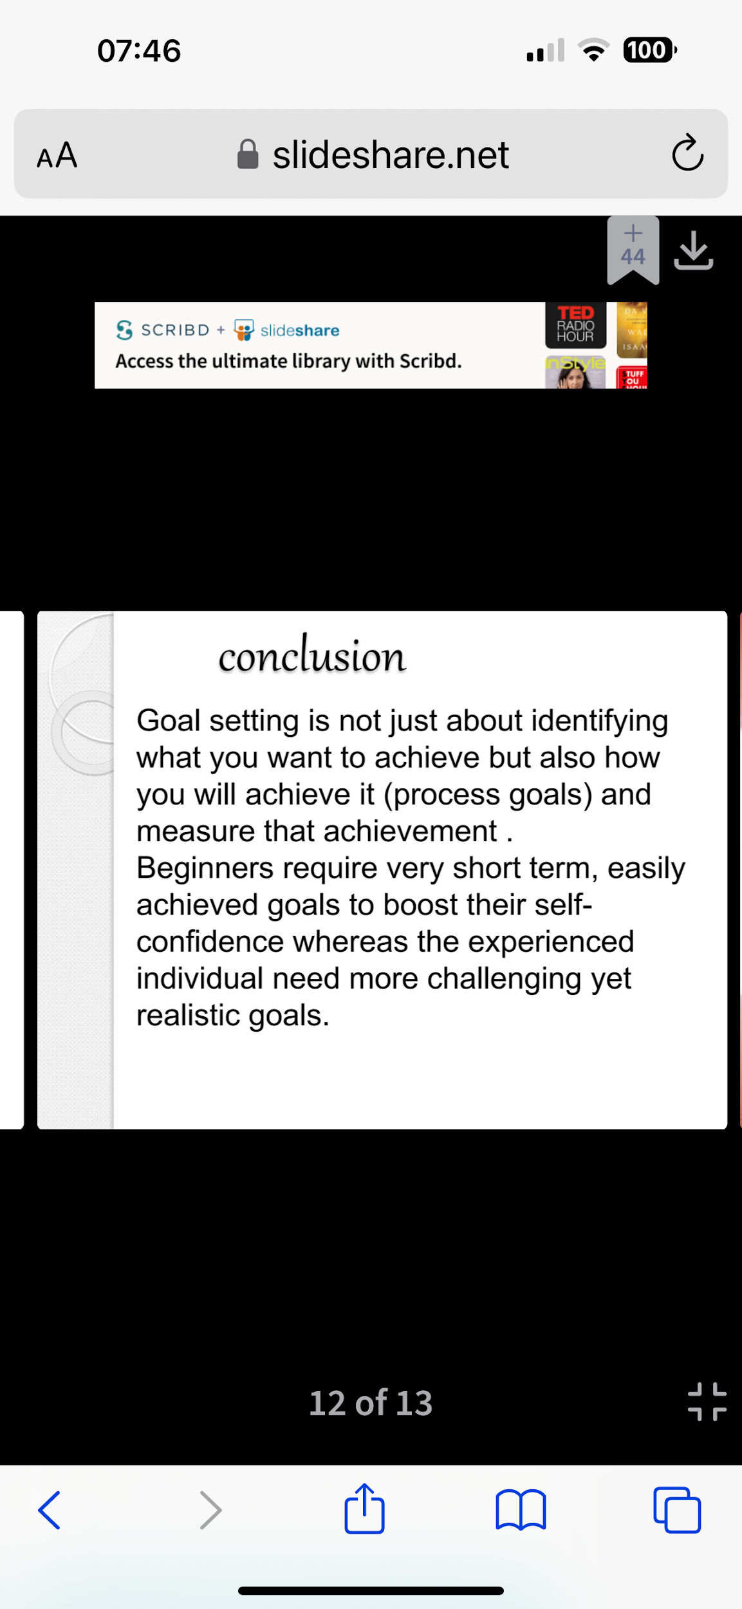

Slide 8
Businesses today are more focused on effective strategic planning and goal setting than ever. At first sight, these processes might seem pretty straightforward. However, there’s so much more going on behind the scenes. Companies dedicate a lot of time and resources to goal based strategic planning.
What are SMART Goals?
S – Specific
M – Measurable
A – Achievable
R – Relevant
T – Time-Bound

Slide 9
What are SMART Goals?
“Goal setting and task performance: 1969-1980” was the first study to promote the importance of setting achievable yet challenging goals. It found that 90% of people perform better with relevant and challenging goals, translating to higher business efficiency and profits.
George T. Doran, a consultant and former Director of Corporate Planning for Washington Water Power Company, first introduced the SMART acronym. He published a paper titled There’s a S.M.A.R.T. Way to Write Management’s Goals and Objectives in November 1981.
Fast forward, the five rules or criteria known as SMART today serve as a psychological tool for increasing productivity. A SMART goal can foster a clear understanding of what constitutes expected performance levels and successful professional development, but also to achieve personal goals.

Slide 10
SMART is an acronym for Specific, Measurable, Achievable, Relevant, and Time-Bound.
The SMART goals acronym eliminates generalization and guesswork, thus setting the base for tracking progress and identifying missed deadlines. When a business entity defines these five parameters, it essentially ensures its team will attain the listed objectives within a predetermined time frame.
What Are The Benefits Of Setting SMART Goals?
SMART is an effective tool with growing popularity. Businesses worldwide incorporate the criteria for strategic planning and goal setting due to the following benefits:

Slide 11
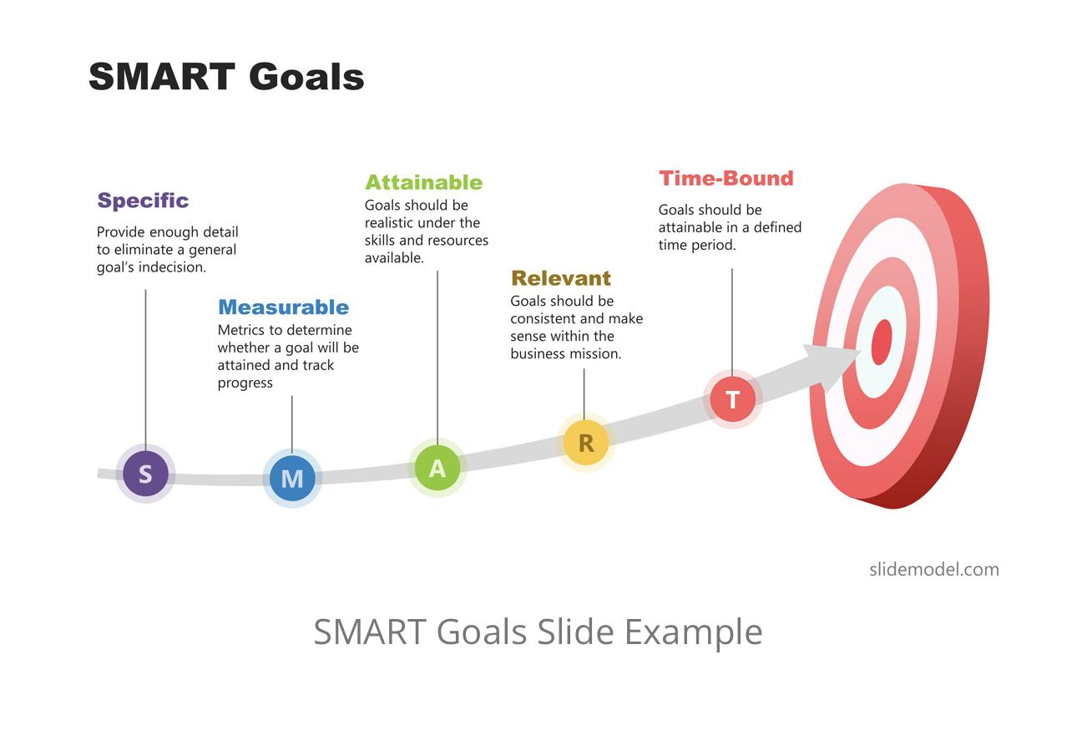

Slide 12
How to Write SMART Goals?
The following section consists of the steps in the process of writing SMART goals, including practical examples to form a comprehensive goal statement.
Setting the Scope of a SMART Goal
SMART goals can address a wide range of job responsibilities, most commonly day-to-day job activities. Business entities primarily apply the SMART criteria to direct their attention and resources towards the most critical aspects of their operation, thus achieving their priorities.
SMART goals can cover different personal or business objectives, such as increasing/decreasing, developing, making, improving, and saving something (resource, expense, revenue, time, etc.).

Slide 13
Setting the scope of a SMART goal is a three-step process with the aim of help meeting personal or business goals:
Defining the different job aspects, broad areas of responsibility, and results for which the business entity (or an individual employee) is held accountable
Developing a goal statement for each particular area of responsibility, focusing on results, not the means to achieve them
Ensuring the scope of each goal is on a high level, enough to encompass core outcomes, not particular tasks
Note: If a business has too many goals, it can indicate that they are developed at a too low level and meeting the business goals can be challenging in these situations. These goals are more task-oriented instead of focusing on the broader picture and the result. A practical solution to this problem is combining several statements into one, more comprehensive goal.

Slide 14
“People work better when they know what the goal is and why.
It is important that people look forward to coming to work
in the morning and enjoy working”.
Elon Musk

Slide 15
Writing The Content Of A SMART Goal
A general goal has a lower chance of being accomplished compared to a SMART goal.
An example of a general goal: “I will increase my profits this year“.
S – Specific
First, SMART goals are always specific, providing enough detail to eliminate a general goal’s indecision.
An example of a specific goal: “The sales department will increase my profits this year by increasing my marketing efforts in the domestic market“.

Slide 16
Specific goals answer the famous “W” questions:
What the business wants to achieve / What steps need to be taken (increase profits)?
Where the process with be taking place (in the domestic market)?
Who will take part in this process / Who is responsible (the sales department)?
Why is the entity pursuing this goal / Why is the goal important (to earn more)?
Which are the requirements, limits, obstacles, and so on?
When, even though this usually translates to the time-bound section (this year)?
Note: Not every specific goal has to answer all questions.
They are given as a starting point; it’s a non-exclusive list.

Slide 17
M – Measurable
A specific SMART goal is a solid base but worth almost nothing without the proper metrics in place.
Setting metrics to determine whether a business will attain the goal and track progress makes the goal more tangible. Usually, this translates to numbers or customer/employee satisfaction.
A measurable goal usually answers questions, such as the following:
How much resources/time/etc?
How many team members/days/etc?
How will we know when it’s done?
An example of a measurable goal: “The sales department will improve my profits by 15% this year by increasing my marketing expenses by 5% in the domestic market“.

Slide 18
A – Achievable
Can the business improve profits by 15% in a single year? Is this the reality of its niche (is it a fast-growing one, is there a demand for these products/services)?
On the other hand, does the entity have the needed capital and resources to increase expenses by 5%? Or will this decision harm its operation, in debt the company in the long-term, or harm its market position?
These, and a range of other questions, should be considered. A business might need to stretch its abilities, develop new skills, change attitudes, or identify previously overlooked opportunities. Still, they should be able to achieve the set goal promptly. If the goal turns out to be too optimistic, the team might think of other, more viable alternatives.

Slide 19
R – Relevant
A single SMART goal statement should be consistent and make sense within the broader image and business mission. All of an entity’s departments should move in the same direction, or in other words, be aligned.
A relevant SMART goal answers the following questions:
Does this idea seem worthwhile?
Is this goal aligned with the overall company’s direction
Are other departments willing to work towards achieving this goal?

Slide 20
T – Time-Bound
The time-bound element in the goal is “this year”, so that there’s no need to expand the statement. Still, it would help to break down the deadline into shorter milestones since a year is pretty broad. A better alternative would be: “The sales department will improve my profits by 3% this month/quarter by … .“
A time-bound goal usually answers the following questions:
When is the deadline?
When is the first milestone, second, and so on?
What can the team do today to move closer to the deadline?

Slide 21
SMARTER Goals templates are usually divided into several sections, taking a form similar to the following:
Initial Goal: Whatever an individual/business has in mind.
Specific: The 6W questions.
Measurable: How to keep a log of progress.
Achievable: Questions to determine whether the goal is realistic.
Relevant: Is the goal aligned with the bigger picture?
Time-bound: When is the deadline for achieving it?
Emotional Involvement:
Results:

Slide 22
Write your goal - Initial Goal: Whatever an individual/business has in mind.
……………………………………………………………………………………………………………….
SMART CHOICE
Specific: The 6W questions.
Measurable: How to keep a log of progress.
Achievable: Questions to determine whether the goal is realistic.
Relevant: Is the goal aligned with the bigger picture?
Time-bound: When is the deadline for achieving it?
Emotional Involvement: What is the emotion you are feeling when thinking about your goal? Are you emotionally involved in your goal? Is your goal in alignement with you?
Results: What is the exact result you would like to see? What is the effect of your goal you would like to see? Is this result in alignement with you?

Slide 23
Email us on:
office@edusmart-tc.net

